Slide 1
Plan – 6 samples per run
First Run
  Thin samples Ru series (4) NT083,84,86,76
  Thickness series (2) 75, 74
  Set 7T (field on always)
  H+(σ+, σ-), H-(σ+, σ-) for each temp (370K, 300K, 200K, 100K, 50K, 10K, 4K)
  Angle scan of NT075 (5 angles)
  NT075 Linear dichroism (s, p ) + angle scan
  NT075 Ru and Ga edge

Slide 2
Plan
Second run
  Thickness series (2) NT073, 72
  Ru content thick samples (4), 59,58,63,55
  H+(σ+, σ-), H-(σ+, σ-) for each temp (400K, 300K, 200K, 100K, 50K, 10K, 4K)
  Florescence
  Control samples to go on the backside

Slide 3
Plan
Third run
  Capping series (4), MgO/AlOx, AlOx, Mg/MgO, Al/AlOx
  Mn2Ga on MRG (2) – 2 thickness of MRG YC267,272
Fourth run
  Cubic Mn2Ga on V composition (5) ,Mn2Ga, Mn2.25Ga,Mn2.5Ga,Mn2.75Ga, Mn3Ga

Slide 4
Ultra thin samples – Ru conc

Slide 5
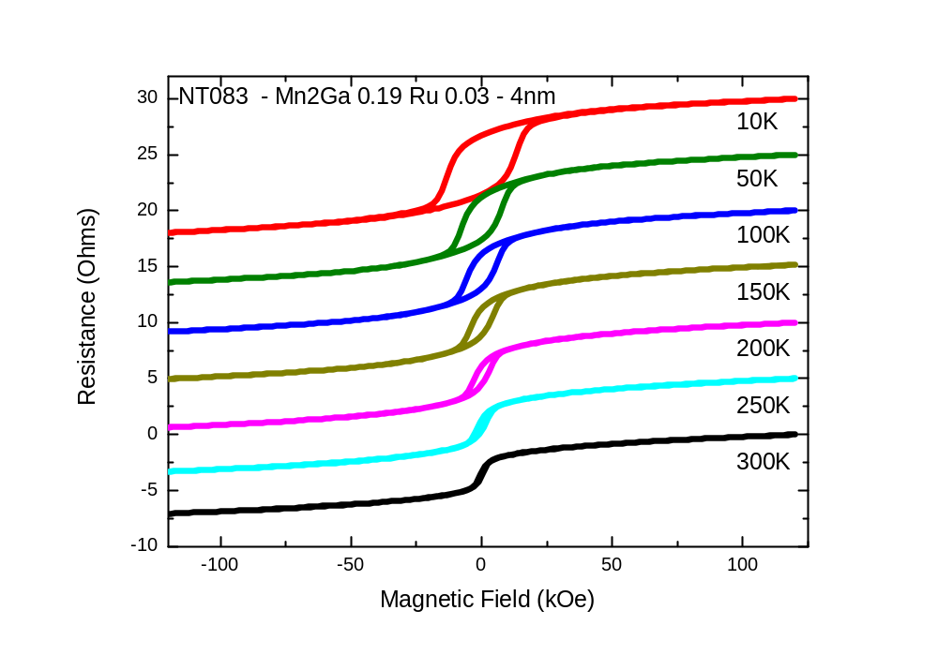

Slide 6
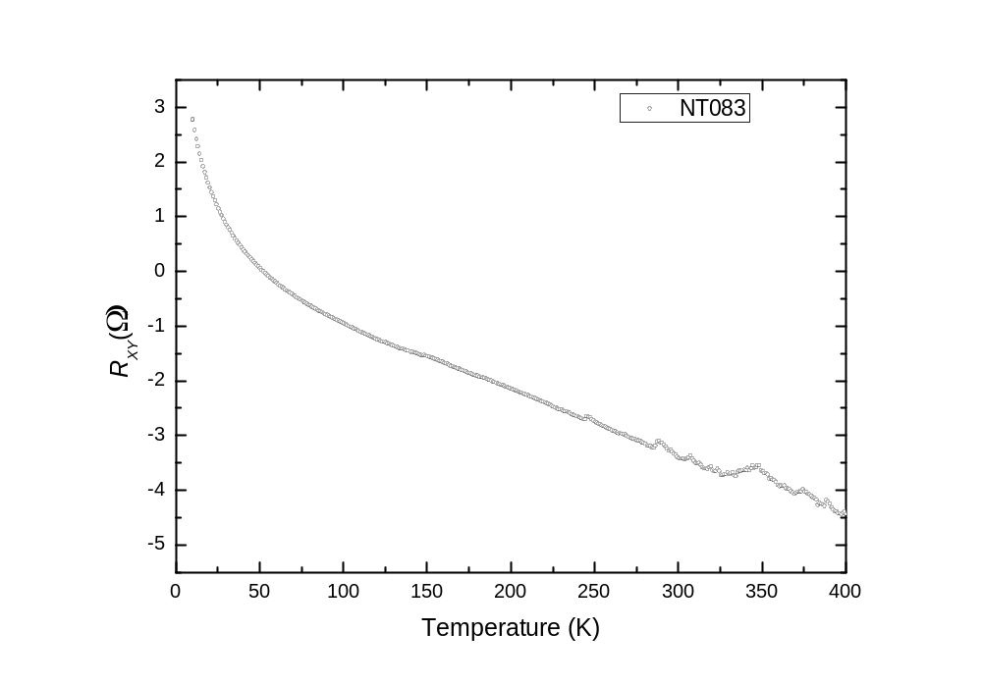

Slide 7
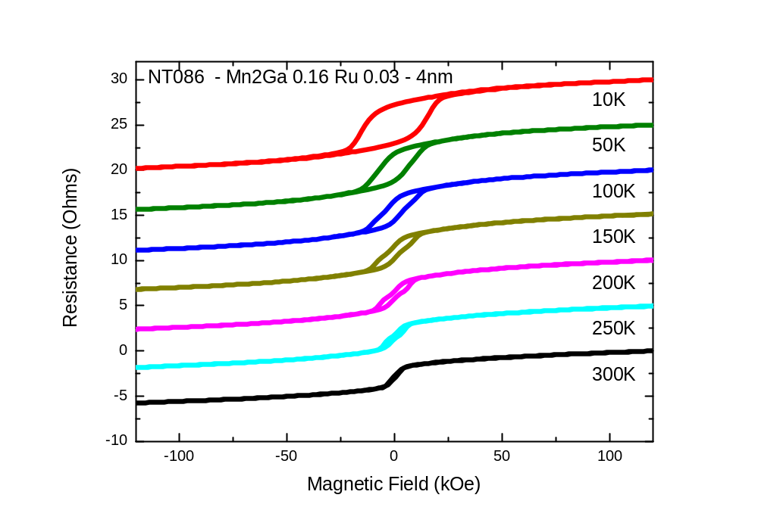

Slide 8
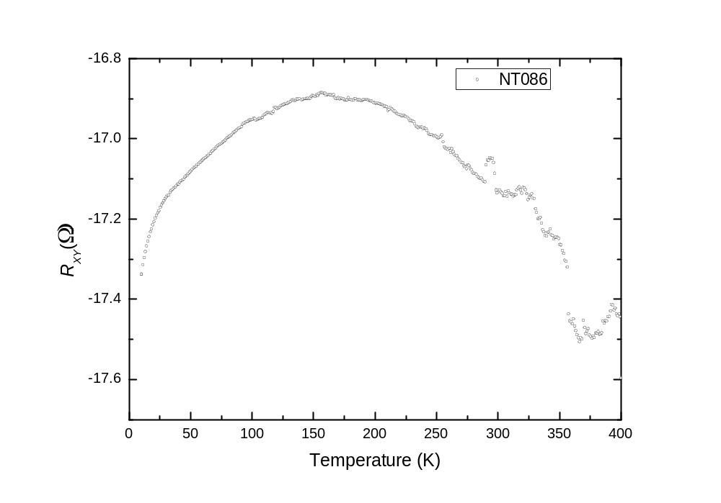

Slide 9
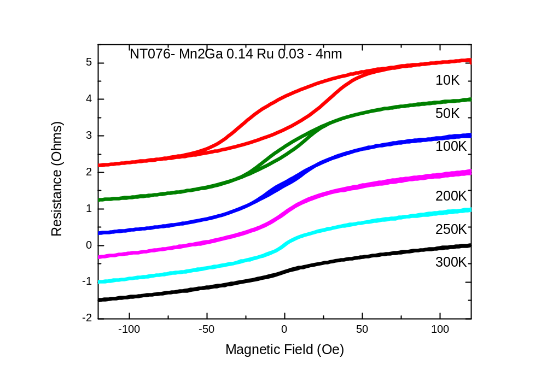

Slide 10
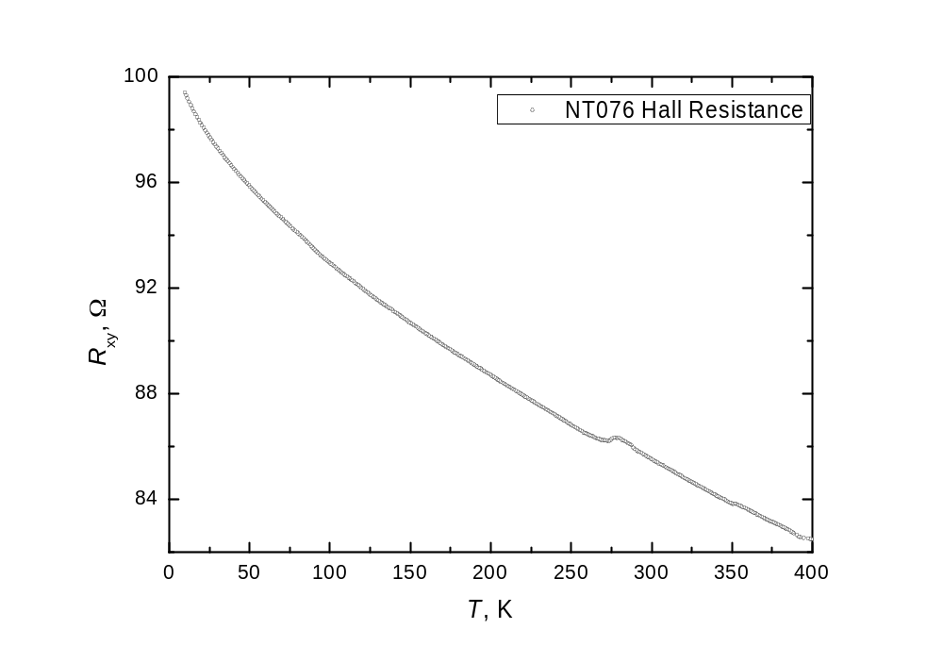

Slide 11
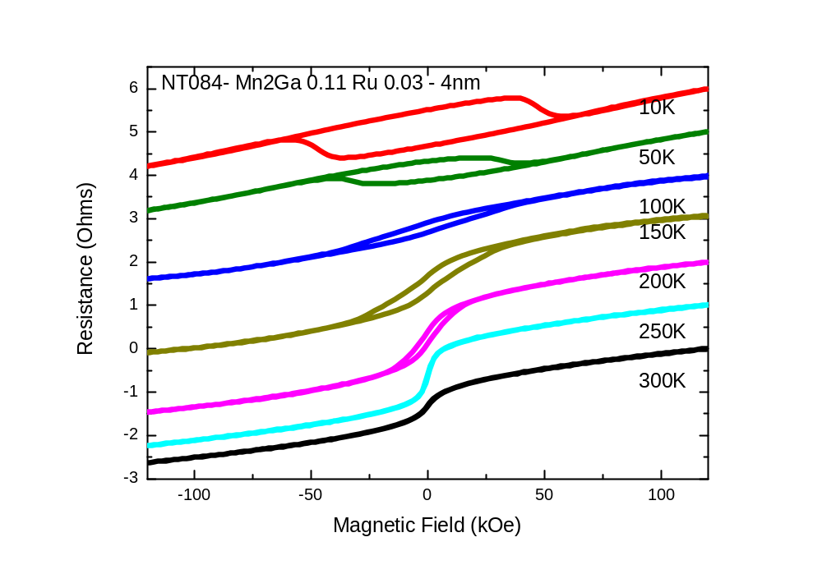

Slide 12
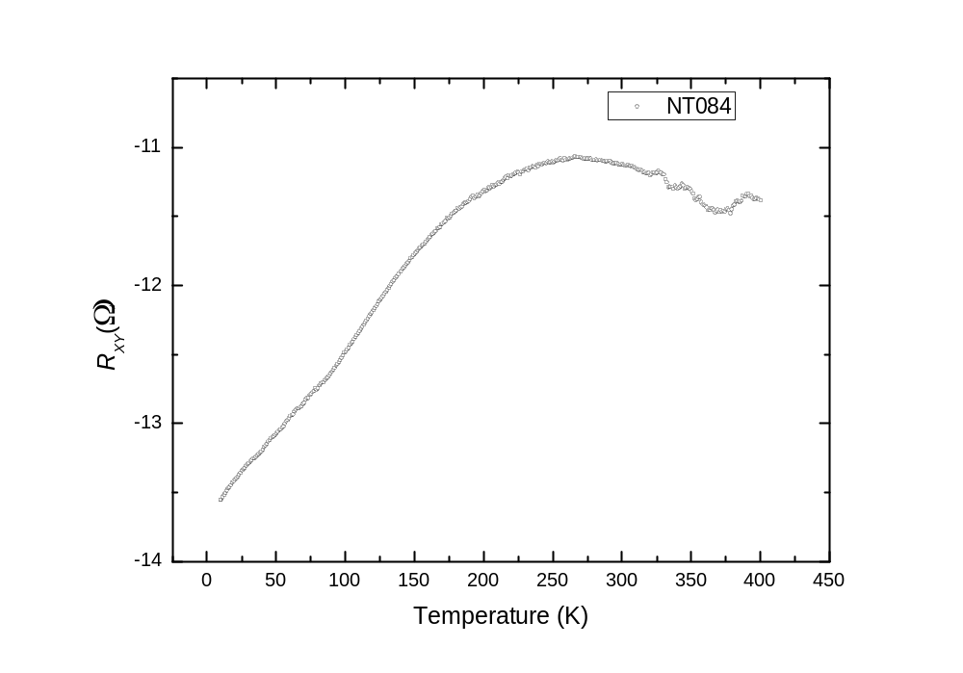

Slide 13
Thickness dependence

Slide 14
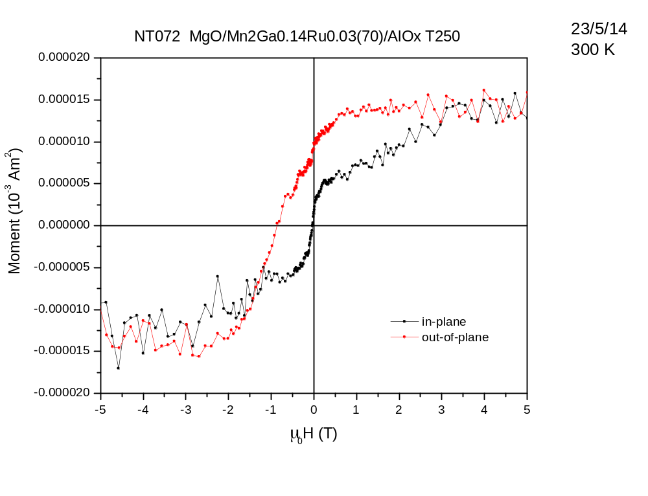
0.08µB

Slide 15
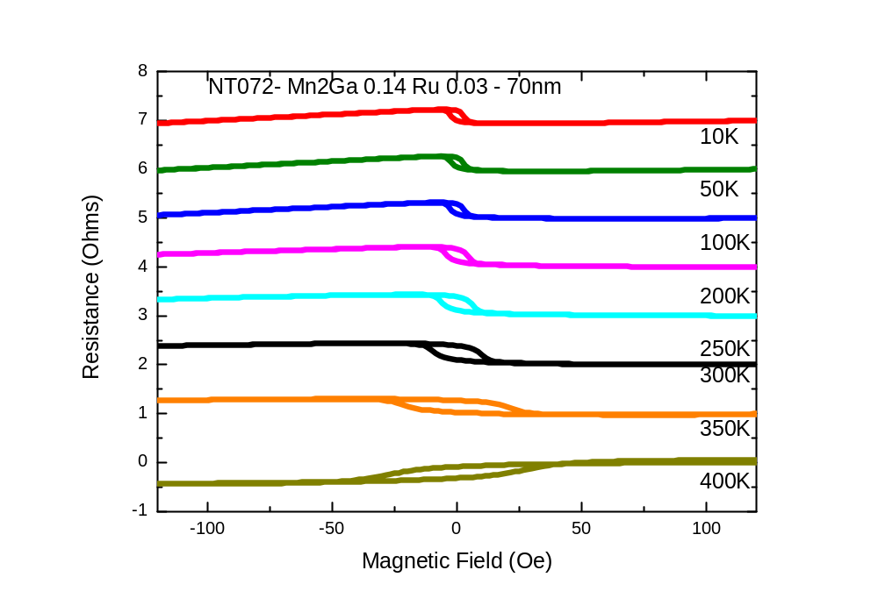

Slide 16
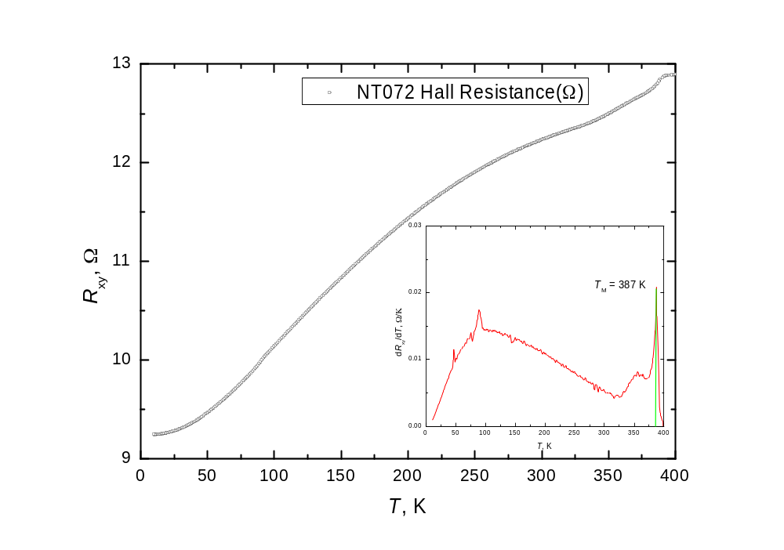

Slide 17
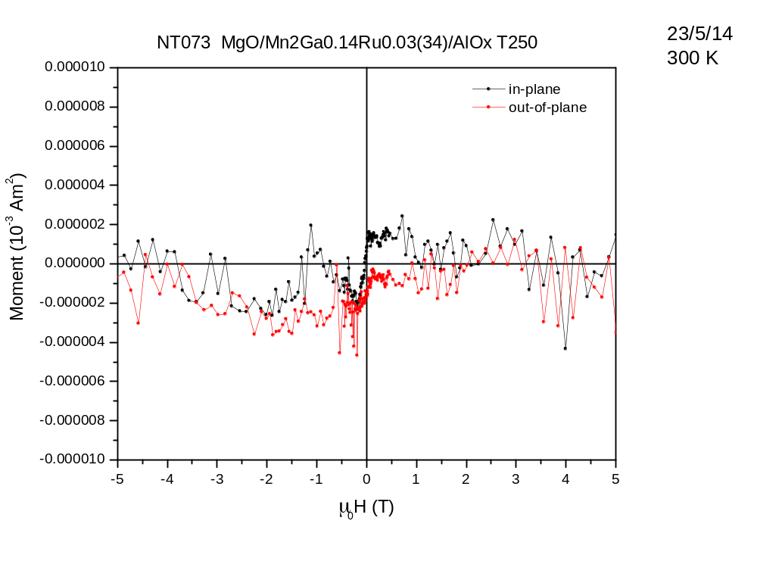
not fully switched (?)

Slide 18
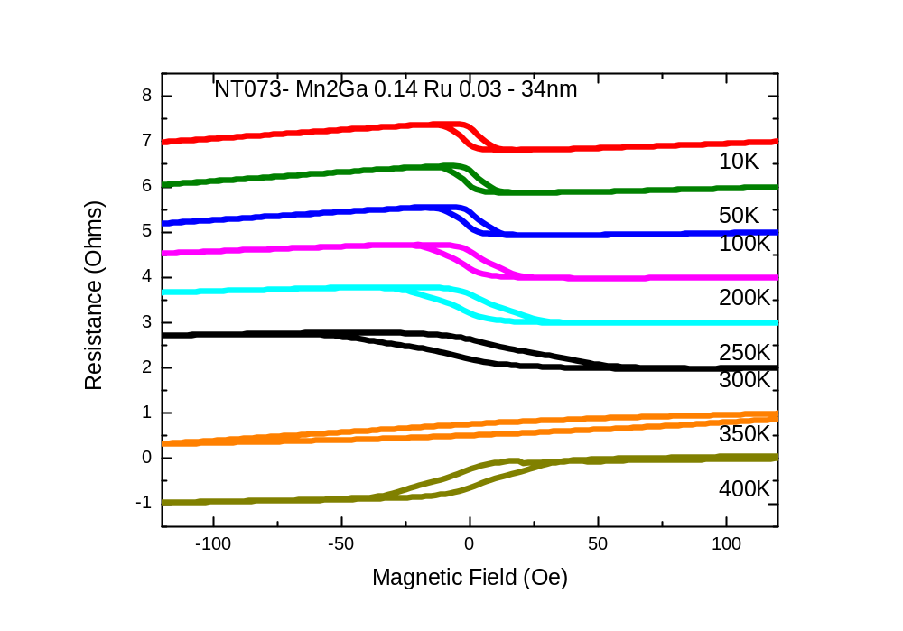

Slide 19
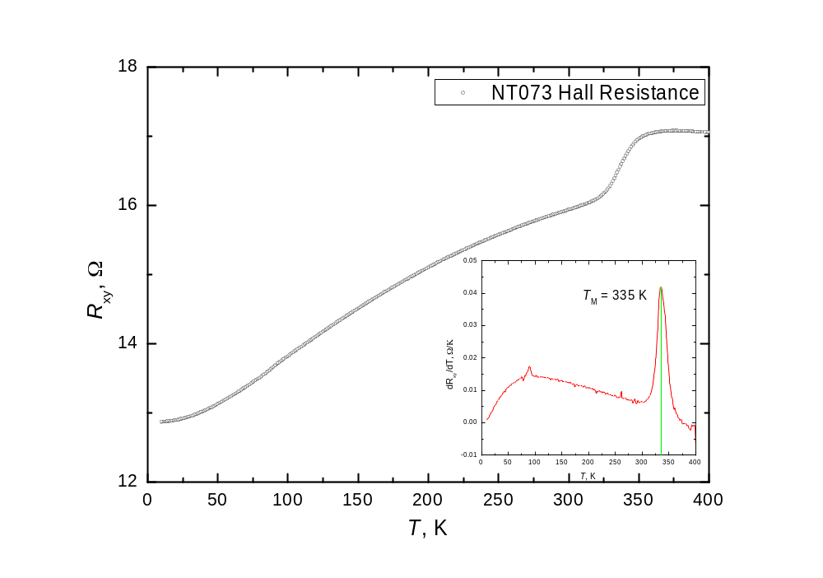

Slide 20
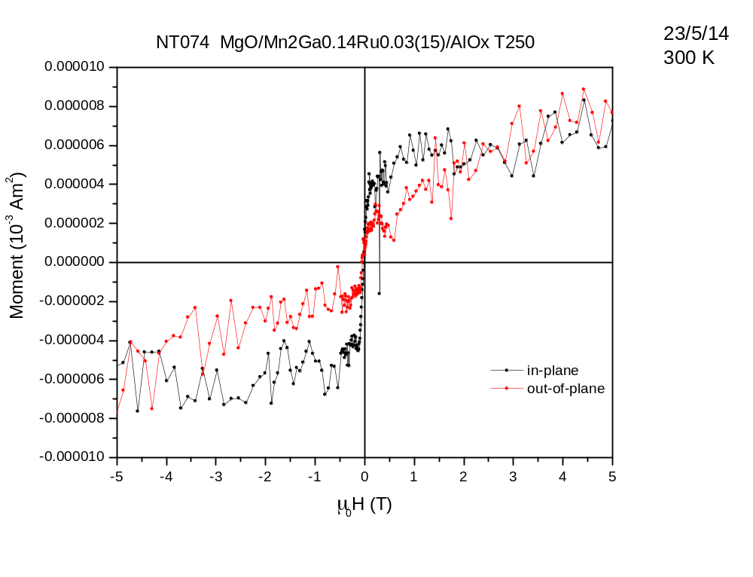
not fully switched (?)

Slide 21
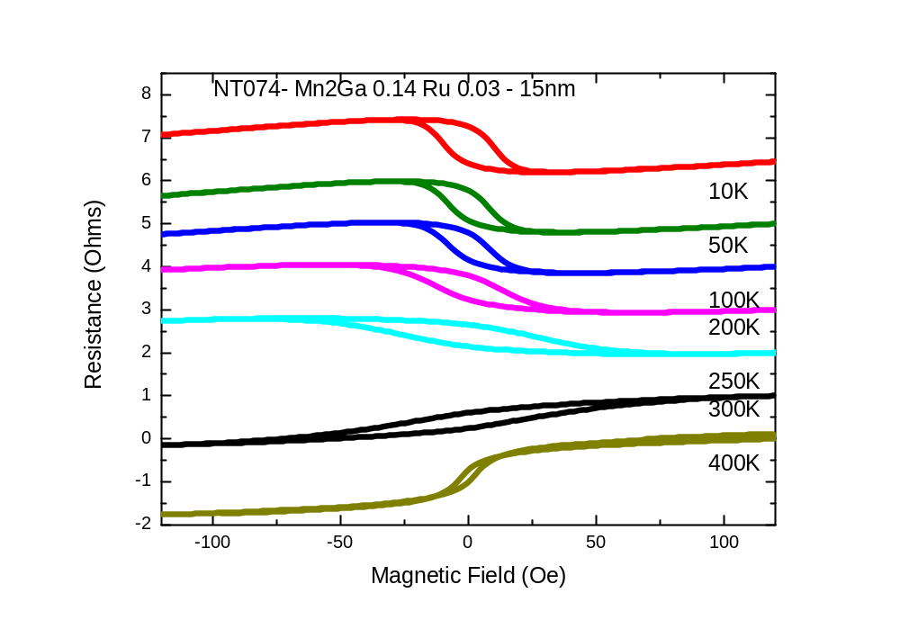

Slide 22
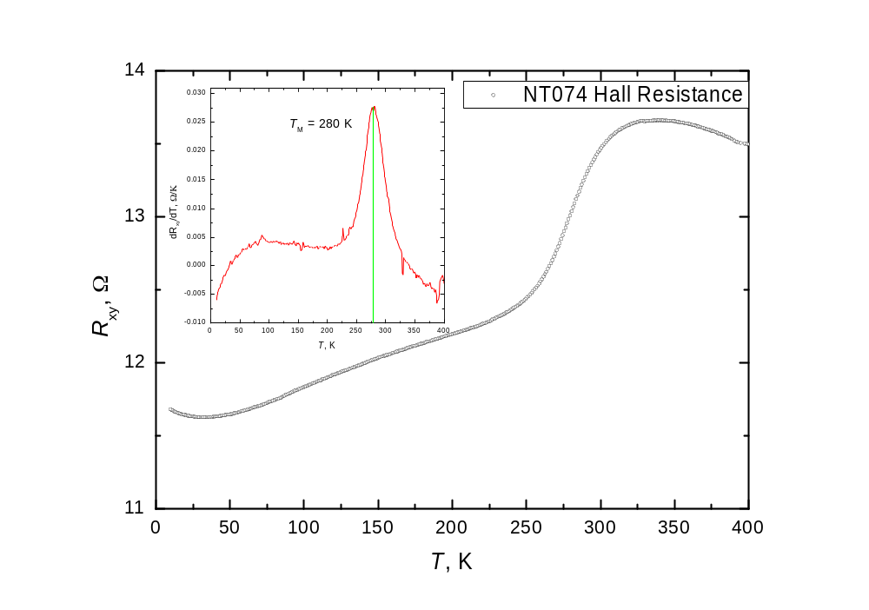

Slide 23
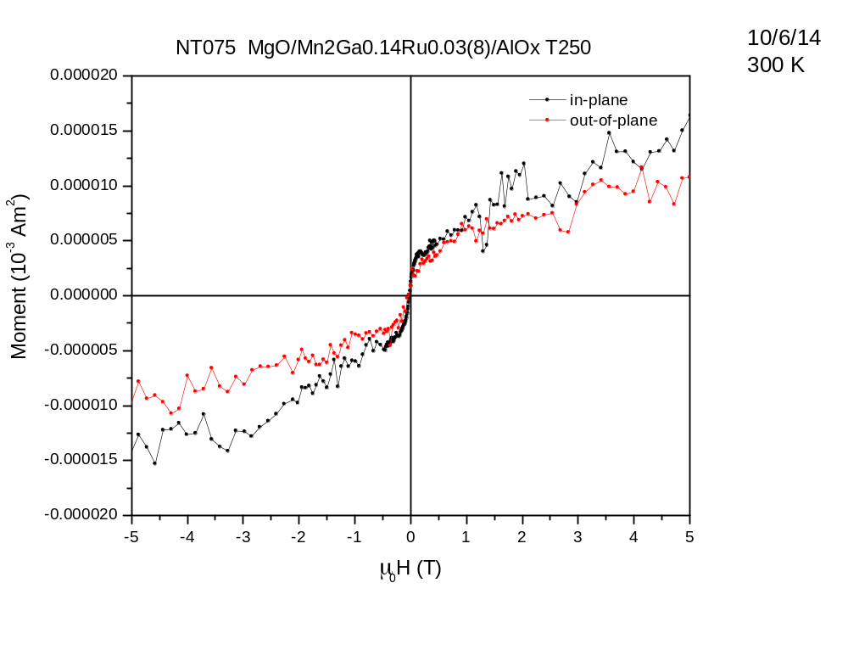
not fully switched (?)

Slide 24
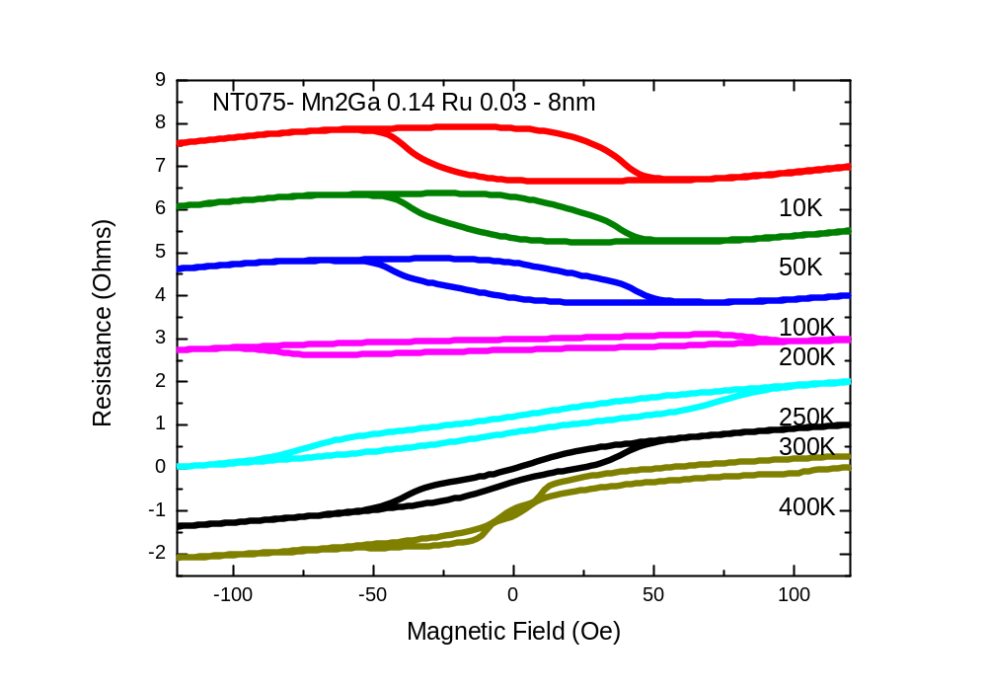

Slide 25
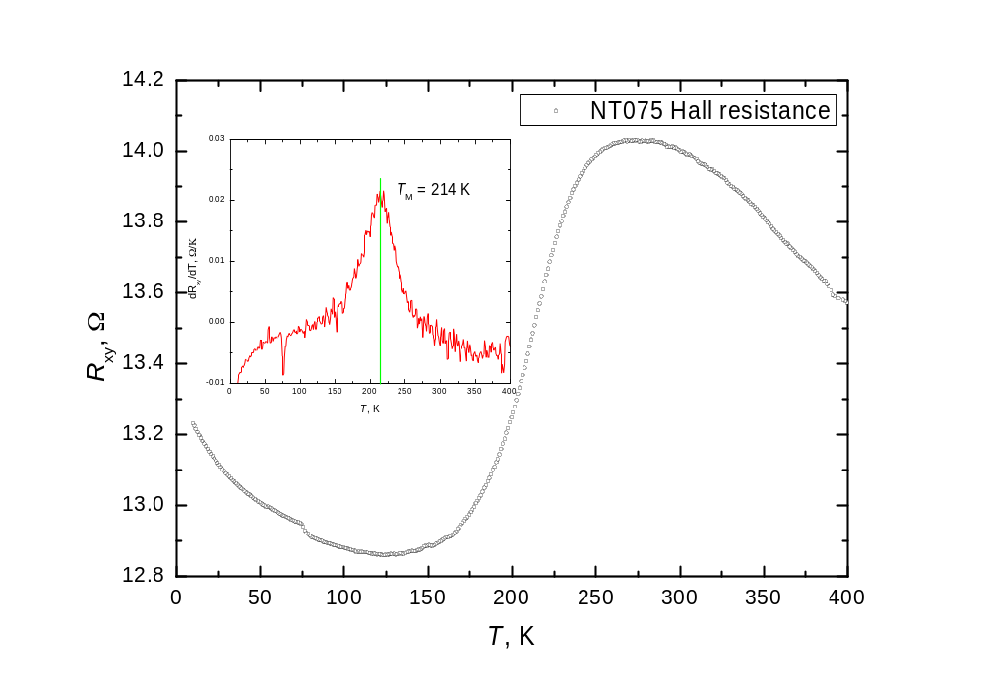

Slide 26
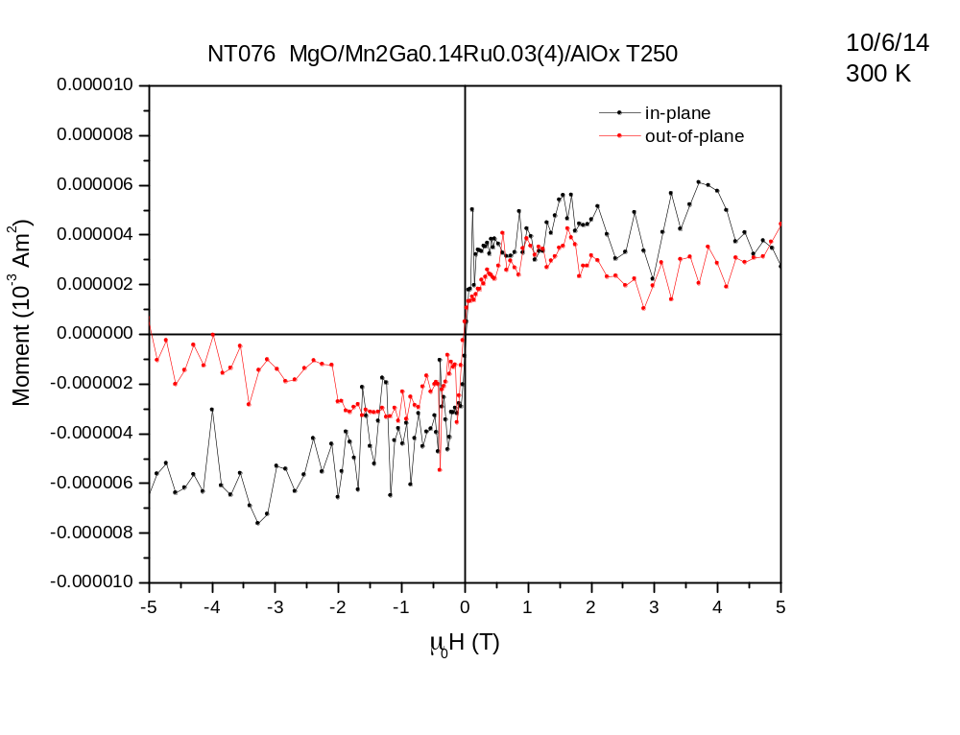
not fully switched (?)

Slide 29
Ru composition series

Slide 30
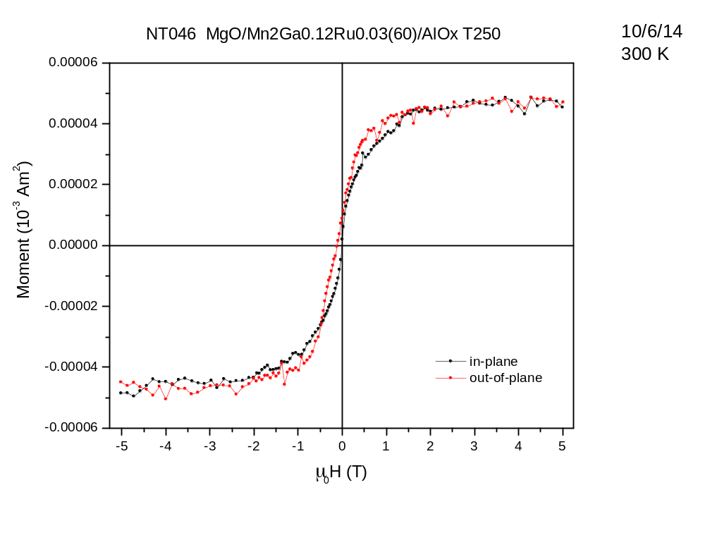
0.26µB

Slide 31
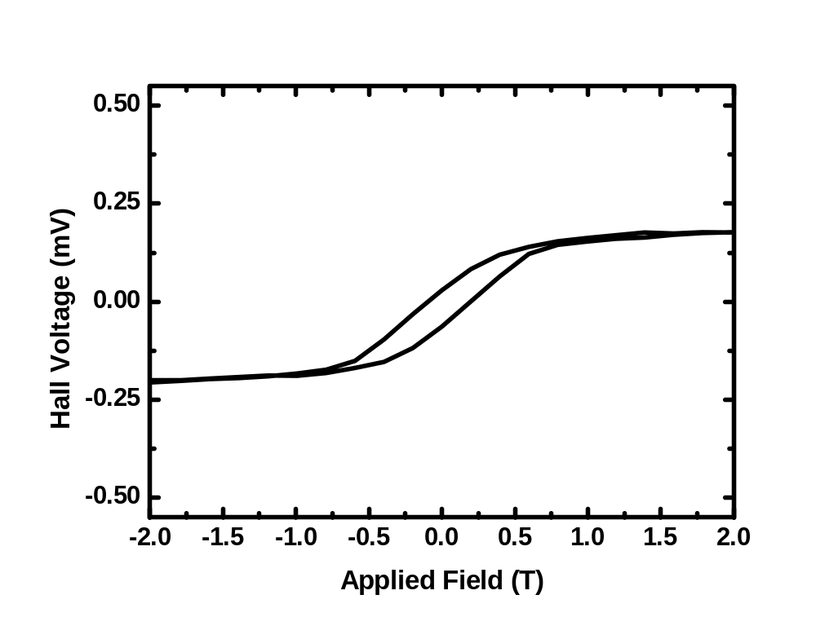
NT046

Slide 32
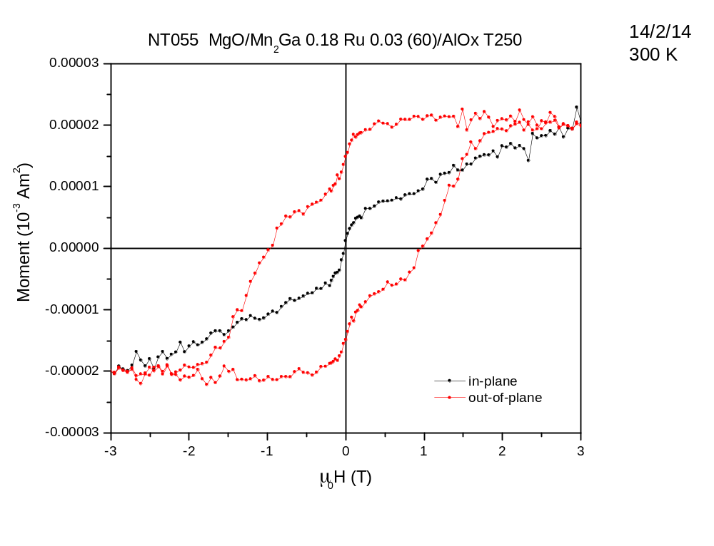
0.11µB

Slide 33
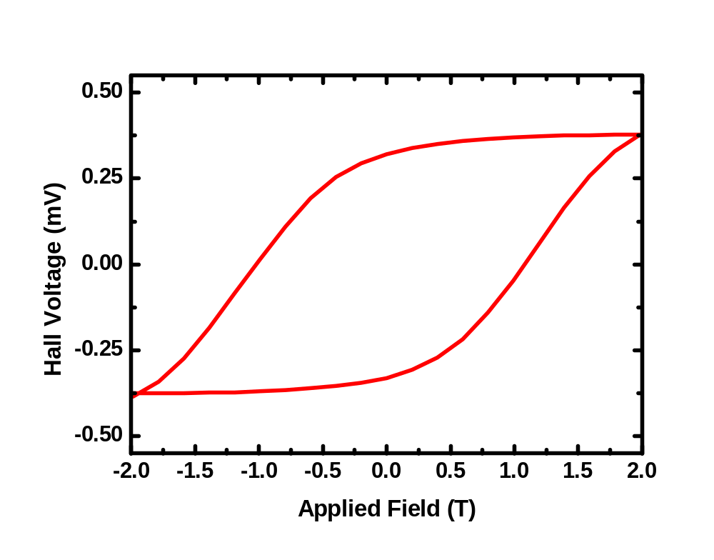
NT055

Slide 34
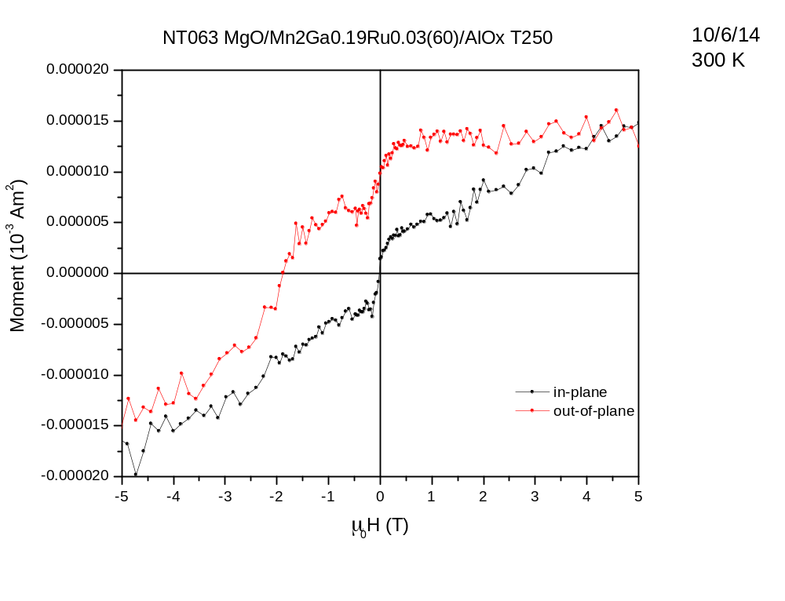
0.09µB

Slide 35
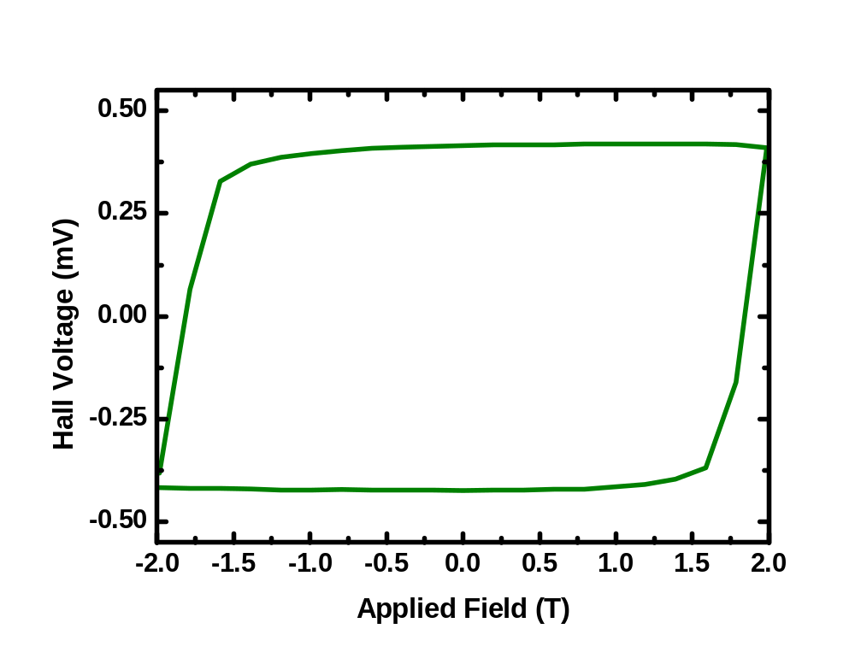
NT063

Slide 36
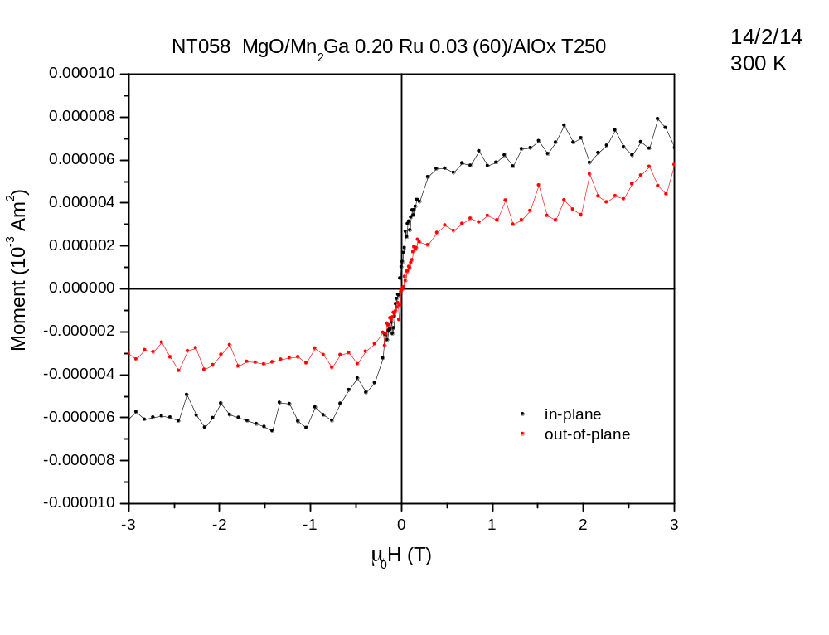
not fully switched (?)

Slide 37
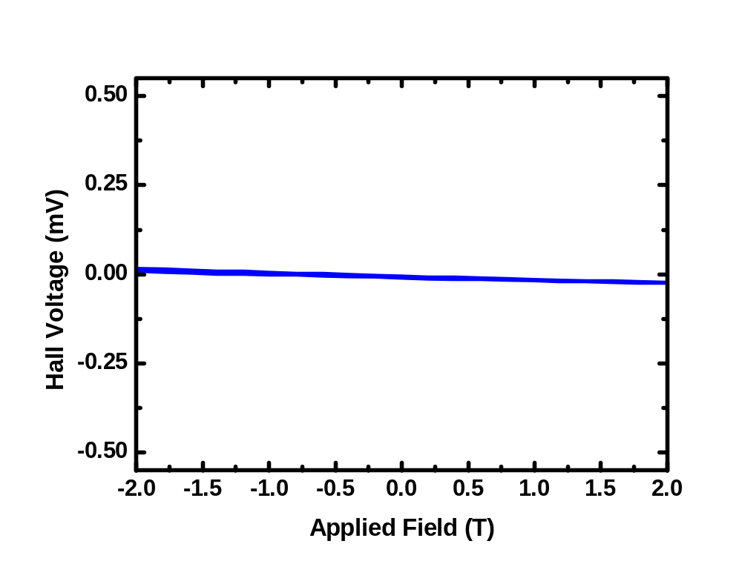
NT058

Slide 38
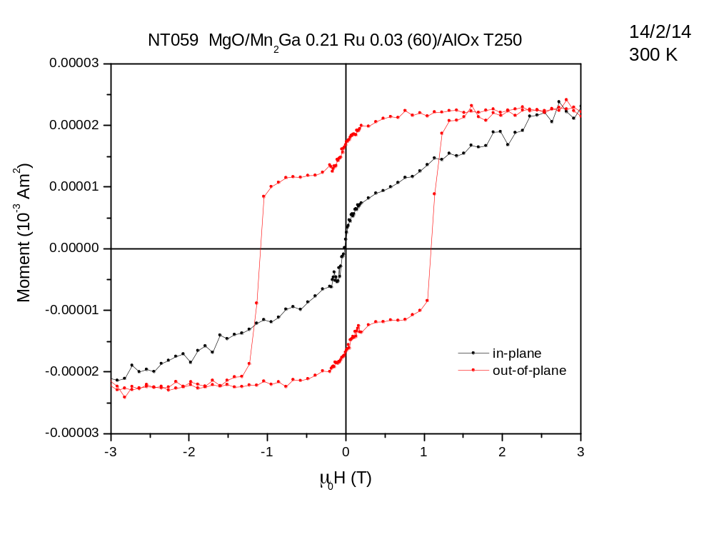
0.10µB

Slide 39
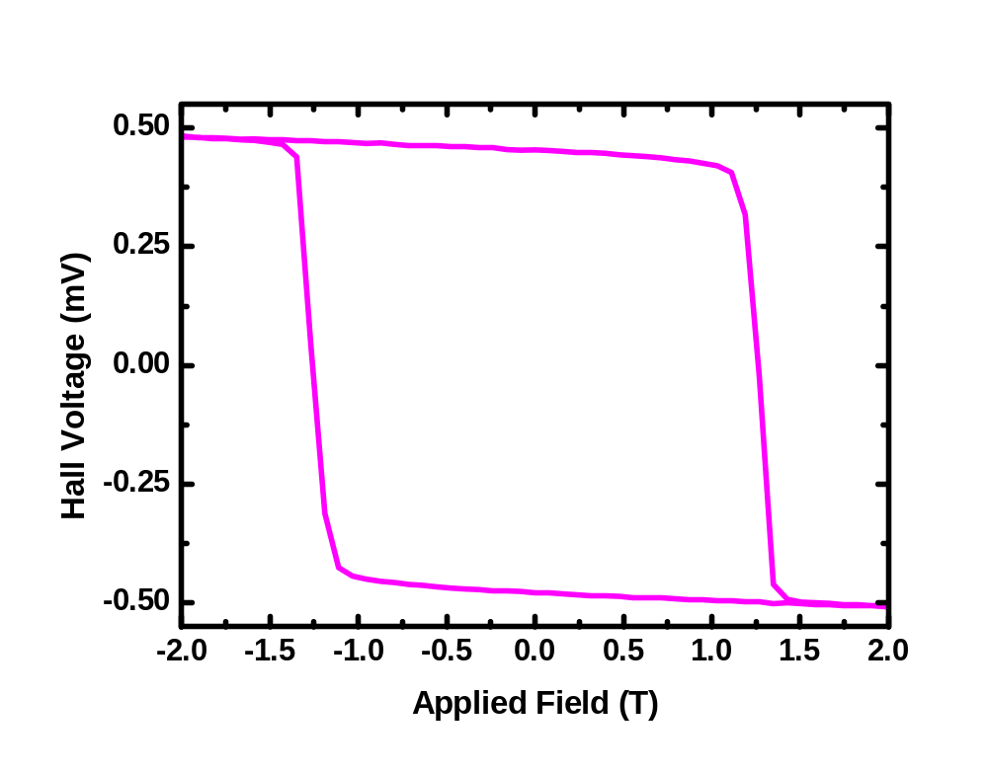
NT059

Slide 40
Mn2Ga on MRG

Slide 41
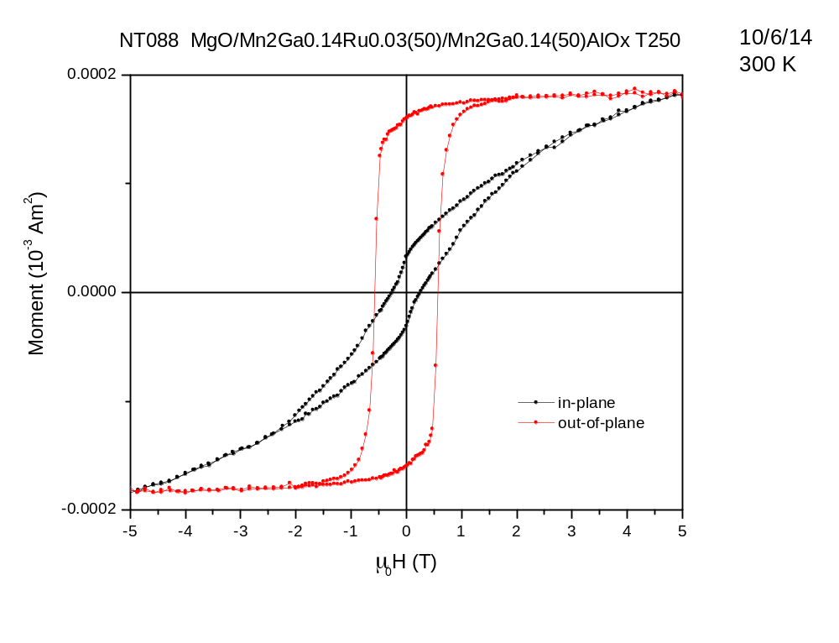
0.96µB

Slide 42
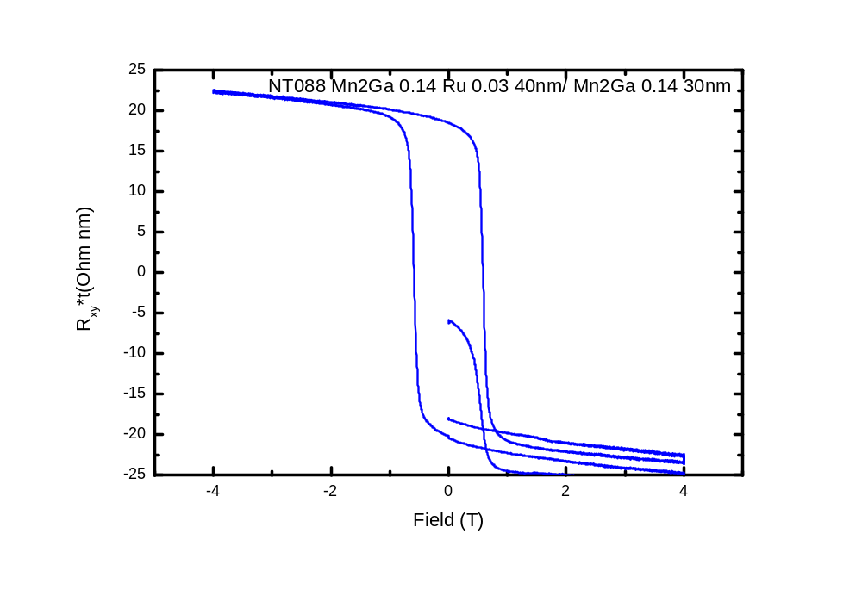

Slide 43
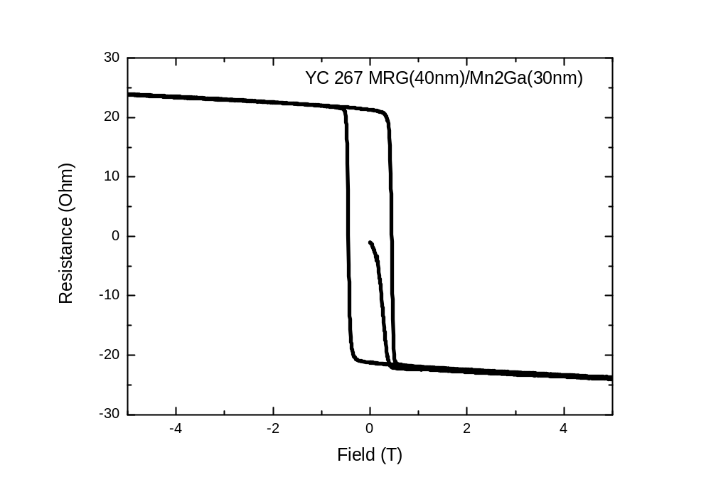

Slide 44
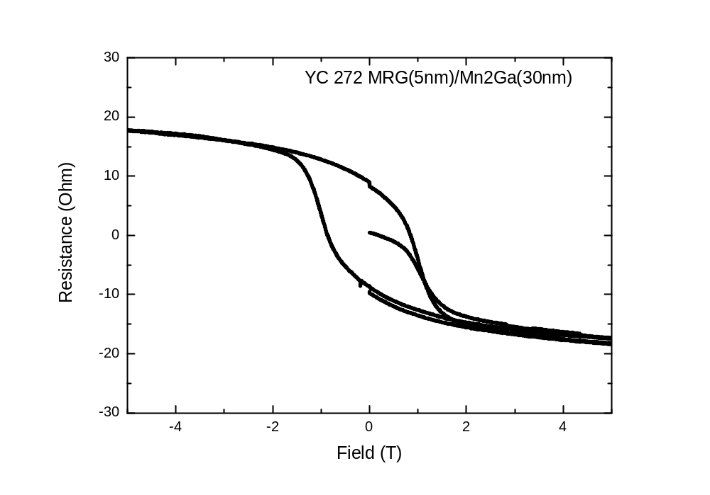

Slide 45
Cubic Mn2Ga / Mn3Ga on V

Slide 46
YC330 Mn2Ga– V(0.1A 30min)/Mn2Ga (0.1A 30min) T350
YC343 Mn2.25Ga– V(0.1A 30min)/Mn2Ga (0.09A) Mn3Ga (0.03A) (25min) T350
YC342 Mn2.5Ga– V(0.1A 30min)/Mn2Ga (0.06A) Mn3Ga (0.06A) (25min) T350
YC344 Mn2.75Ga– V(0.1A 30min)/Mn2Ga (0.03A) Mn3Ga (0.09A) (25min) T350
YC341 Mn3Ga– V(0.1A 30min)/Mn3Ga (0.1A 30min) T350

Slide 47
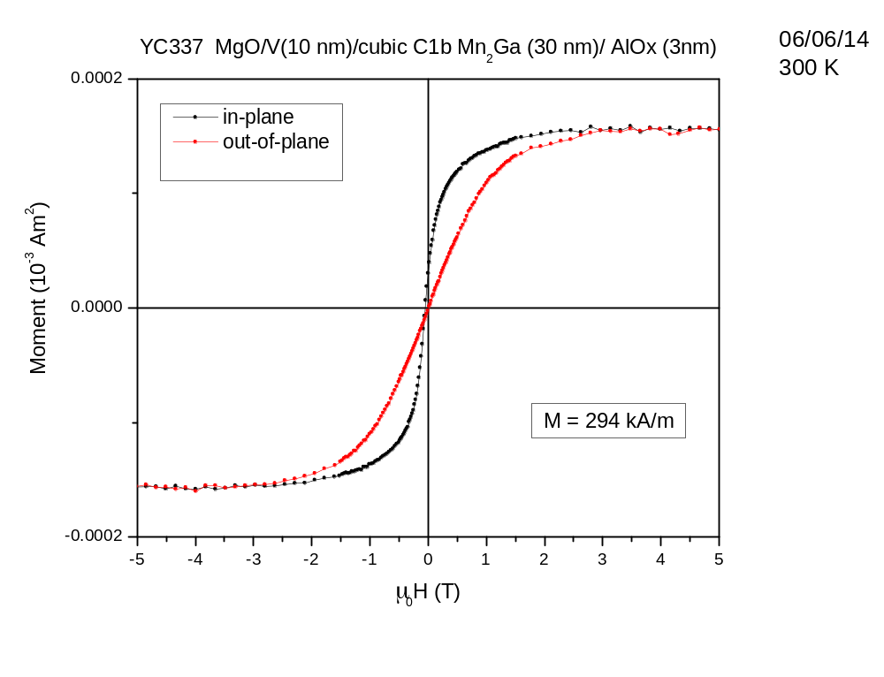

Slide 48
Pure materials , Mn, Ru, and/or oxides
Ru metal
Mn metal
Mn(II)oxide
Mn(IV)oxide
Ga(III)oxide

Slide 49
MRG capped with diff tunnel barriers

Slide 50
Lattice Parameters
Sample | c (A)
NT046 | 6.06364
NT055 | 6.0724
NT063 | 6.06488
NT058 | 6.07324
NT059 | 6.06728
NT072 | 6.06531
NT073 | 6.07041
NT074 | 6.08917
NT075 | 6.12888
NT076 | 6.17176
NT083 | 6.20556
NT084 | 6.19568
NT086 | 6.19044
NT088 | 6.07584
YC267 | 6.0714
YC272 | 6.00936
YC330 | 5.83496
YC343 | 5.82628
YC342 | 5.83132
YC344 | 5.82516
YC341 | 5.8372
YC268 | 6.0044

