Slide 1
EPICS Training 2015
Using Motors
Ronald L. Sluiter
2015-02-16

Slide 2
Overview
Acknowledgements.
What’s in the EPICS motor module and what’s it for?
Supported motor controller Manufacturers and models.
Motor record features.
Configuration example.
Feedback.
Retries.
Backlash Correction.
Distribution.
Note: All of following refers to R6-9 of the motor distribution.

Slide 3
Acknowledgments
Jim Kowalkowski - original author, until…
Tim Mooney and Joe Sullivan, until…
Myself, since 1998/9, until…
Kevin Peterson and myself are the current “module owners”.
Many contributors to the motor module.
  Mark, BCDA, Diamond Light Source, vendors

Slide 4
Terminology
MM ⬄ Motor Module distribution
MR ⬄ Motor Record
EGU ⬄ Engineering Units
RPS ⬄Revolutions Per Second
Stepper motors step and encoders tick.
Readback ⬄ Feedback
target position - a user requested, static, absolute position (VAL).
commanded position – the motor controller’s current, dynamic, absolute reference position (RMP).

Slide 5
What’s in the Motor module?
User displays - medm, CSS/Boy, caQtDm (mostly commissioning, some application specific; e.g., fly scanning) (Location: <motor>/motorApp/op/*)
Databases – (templates referenced by *.substitution files) (Location: <motor>/motorApp/Db)
The MR (*.dbd and 4,000+ *.cc) and common device/driver code shared by all device/drivers (Location: <motor>/motorApp/MotorSrc)
  3 different motor module device/driver architectures.
  Model 1 (unique device, used asyn for comm.), Model 2 & 3 (common device, asyn integral)
  https://subversion.xray.aps.anl.gov/synApps/motor/trunk/documentation/motorDeviceDriver.html
Vendor specific directories, device/driver code and *.dbd (README docs) (Location: <motor>/motorApp/<vendor-name>Src).
Save/restore *.req files (Location: <motor>/motorApp/Db).

Slide 6
What’s in the Motor module?
Two IOC build examples (w/ and w/o Asyn) with motor device/drivers (build option) (Location: <motor>/motorExApp)
iocBoot examples (controller specific st.cmd and supporting *.cmd files) (build option) (Location: <motor>/iocBoot/*)
Documentation (release notes, motor record and device/driver info) (Location: <motor>/documentation)

Slide 7
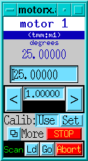
What’s the Motor module for?
Device independence – motor hardware is transparent to users.
  Same user displays and motor motion behavior, for all devices.
Available operations from this display;
Make absolute or incremental moves.
Define the current position.
Stop the current move.
without any controller specific information.
  Common device and driver level software for all supported controllers.
  Unsupported MR features are handled at the device/driver level; typically, by ignoring the request (the price - LCD motor record features).

Slide 8
Supported Manufacturers
Pro-Dex (OMS)
Newport
Schneider Electric
Advanced Control Systems
Mclennan
Physik Instrumente (PI)
MicroMo
Micos
Faulhaber
Parker Hannifin
New Focus
ACS Motion Control
Spectra-Physics
Thorlabs
Animatics
piezosystem
Kohzu
attocube
Aerotech
Hytec
nPoint
Micronix
SmarAct
Phytron

Slide 9
Does motor controller XYZ have EPICS support?
Motor record document.
  http://www.aps.anl.gov/bcda/synApps/motor/R6-9/motorRecord.html
  MM location: <motor>/documentation/motorRecord.html
EPICS Hardware Support: by Manufacturer
  http://www.aps.anl.gov/epics/modules/manufacturer.php
  Not all controller support is distributed in the MM; e.g., Galil
EPICS tech-talk (search - ask)
  http://www.aps.anl.gov/epics/tech-talk/index.php
  Search for “Delta Tau Turbo PMAC2 VME Ultralight”
    http://www.aps.anl.gov/epics/tech-talk/2014/msg01793.php
Support for stepper, servo, piezo (deflection and slip-stick) motors.

Slide 10
Features - scope
The scope of the MR is limited to single axis, non-coordinated, point to point moves.
For multi-axis coordinated motion and trajectory scans see…
  https://subversion.xray.aps.anl.gov/synApps/motor/trunk/documentation/trajectoryScan.html

Slide 11
Features - coordinate systems.
steps or ticks
RVAL
Raw
MRES
X
EGU’s
DVAL
Dial
DIR: +/- 1
X
+
OFF
VAL
User

Slide 12
Features - coordinate systems.
Some controllers use raw units to communicate.
  The MR communicates to device support in raw units.
  Position, velocity and acceleration MR commands to device support are in steps, steps/sec and steps/sec^2.
Other controllers communicate in engineering units (EGU’s); e.g., inch, mm, degrees. Device support handles the conversion.
Motor resolution field (MRES) converts raw values to dial values.
  Convert raw target position (RVAL) to dial target (DVAL):
    DVAL [EGU’s] = RVAL [steps] * MRES [EGU’s/step]
User units are based on dial units, the User Direction field (DIR) and the User Offset field (OFF)
  Convert dial target position (DVAL) to user target (VAL):
    VAL = (DVAL * DIR) + OFF; where DIR = +/- 1.

Slide 13
Features – Move types
Absolute (VAL, DVAL, RVAL)
Relative (RLV)
Incremental (TWF, TWR, TWV)

Slide 14
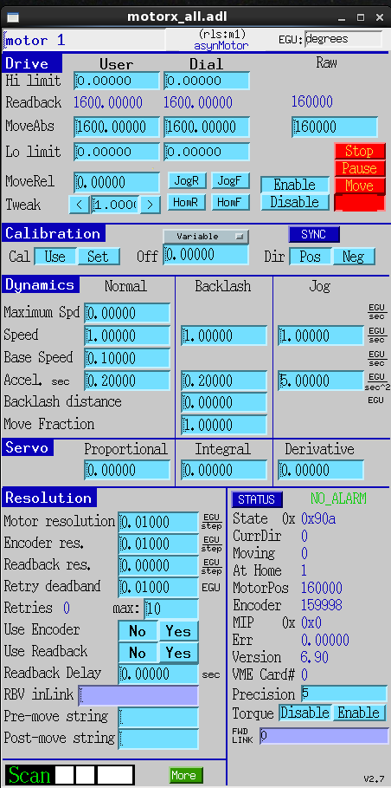
VAL
RVAL
RLV
DVAL
TWF/TWR
TWV

Slide 15
Features – Velocity and Acceleration
Maximum Velocity (VMAX).
Slew Velocity (VELO)
Base Velocity (VBAS) – for stepper motors only to minimize resonance.
Slew Acceleration time (ACCL [sec]) – acc. rate [step/s^2] = (VELO - VBAS) / ACCL

Slide 16
VMAX
VELO
VBAS
ACCL

Slide 17
Features – Homing, Jogging
Home search (HOMF, HOMR, HVEL).
Jogging (JOGF, JOGR, JVEL, JAR).
Safety issues
  Commissioning a stage? Check hardware limit switches 1st.
  pinch hazards, remote operation, servo systems

Slide 18
JOGF/JOGR
HOMF/HOMR
JVEL
JAR

Slide 19
Features – Set position, soft travel limits
Define current position (SET, FOFF).
Software travel limits (HLM, LLM, DHLM, DLLM) (disabled if DHLM = DLLM = 0)

Slide 20
HLM/LLM
DHLM/DLLM
FOFF
Set

Slide 21
Features
Send motor controller command primitives at initialization, pre-move and post-move; (INIT, PREM, POST).
Drive Power Monitoring and Motor Synchronized DB Puts via Device Directives.
User initiated updates via the Status Update field (STUP).
A few fields are motor type specific;
  PID parameters (PCOF/ICOF/DCOF) for servo motors (normalized to 0 -> 1).
  Velocity base (VBAS) for stepper motors.
  Done Moving Input Link (DINP) for Soft Channel.
Position feedback from either a EPICS PV link or a motor controller.

Slide 22
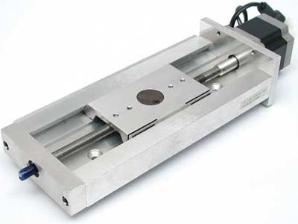
Configuration example
Set the engineering units field (EGU); inch, mm, degrees .
Set the motor resolution (MRES) field which is in units of …
  (EGU’s / motor step) for stepper motors.
  (EGU’s / encoder tick) for servo motors.

Slide 23
Cont'd Configuration example
What should MRES be set to?
For a simple linear stage with a leadscrew directly driven by a stepper motor.

Slide 24
Cont'd Configuration example
UREV = EGU’s / 1 leadscrew rev.
SREV = motor steps / 1 motor rev. > 0
MRES = UREV / SREV
MRES and UREV allow negative values so that the record’s coordinate system can be configured to the opposite polarity of the motor controller's.
Never change MRES while the motor is moving.

Slide 25

Cont'd Configuration example
Gear box example
  Gear ratio definition; “The ratio of the powered gear of a gear train to that of the final or driven gear.” Hence, a 3:1 gear ratio means that the motor makes 3 revolutions per 1 revolution of the lead screw
For a servo motor with a motor mounted encoder, change motor steps to encoder ticks.

Slide 26
Feedback
Two ways to input position feedback to the motor record:
  From driver support, via the motor controller.
  From an EPICS PV, via a stand-alone, feedback device,
For feedback from driver support:
  Driver level code sets the Encoder is Present bit (EA_PRESENT) in the Motor Status field (MSTA) to True at initialization.
  The Raw Encoder Position field (REP) has the motor controllers’ raw encoder value [ticks].
Configuring feedback from driver support:
  Set the Encoder Resolution field (ERES) to convert encoder ticks to EGU’s.
  The Use Encoder If Present field (UEIP) determines if the REP is used [Yes/No].

Slide 27
Cont'd Feedback
Configuring feedback from an EPICS PV:
  Set Readback PV link (RDBL).
  Set the Readback Resolution (RRES) to convert the RDBL PV units to EGU’s.
  The Use Readback If Present field (URIP) determines if the RDBL PV link is used [Yes/No].
Raw Motor Position (RMP) is the current commanded position read from the motor controller. If motor record closed-loop control is off (UEIP & URIP both set to No), then RVAL = RMP after every move.
Raw Readback Value field (RRBV) can be in units of either steps or ticks.

Slide 28
RRES
URIP
RDBL

Slide 29
Feedback data flow
MRES
ERES
RMP
UEIP = URIP = No, OR,
URIP = Yes
DIR: +/- 1
UEIP = URIP = No
UEIP = Yes
REP
UEIP = Yes
RRBV
X
DRBV
X
+
RBV
URIP = Yes
OFF
÷
MRES
RDBL Link
X
RRES

Slide 30
RRBV
RVAL
RRES
STUP
UEIP
RMP
URIP
REP
RDBL

Slide 31
Retries
What it isn’t. Retries are not continuous, dynamic loop closure.
What it is. Retries try to eliminate dial position error (DIFF) by making, consecutive, relative moves based on the DIFF field.
DIFF = DVAL – DRBV
If [RTRY !=0, AND, ((EA_PRESENT = True, AND, UEIP == Yes), OR, URIP == Yes)] is True, then all motor record moves are relative moves.
Configuring retries:
  Usually set UEIP == No for a servo motor.
  Set Retry Deadband (RDBD); retry if (DIFF > RDBD).
  Set Max Retry Count (RTRY) - maximum number of retries.
  Current Retry Count (RCNT) – cleared at the start of every move.

Slide 32
RDBD
RCNT
DIFF
RTRY

Slide 33

Backlash Correction
Backlash - lost motion due to mechanical imperfections.
Backlash configuration:
  Backlash distance (BDST) determines the magnitude and direction of the backlash move.
  The backlash has its’ own velocity (BVEL) and acceleration (BACC) parameters.
Backlash correction algorithm:
  Preferred direction - the sign of BDST.
  Slew parameters - slew velocity (VELO) and acceleration (ACCL).
  Backlash parameters - BVEL and BACC.

Slide 34
Backlash Correction Logic
Given a move to a position called Target:
IF backlash is disabled (0 = |BDST| < |MRES|), OR, (move is in the preferred direction, AND, backlash parameters == slew parameters).
  THEN, skip backlash, move to Target using slew parameters.
ELSE IF the incremental distance > |BDST|, OR, the move is Not in the preferred direction.
  THEN, move to position (Target - BDST) using slew parameters, then move to Target using backlash parameters.
ELSE IF the incremental distance <= |BDST|, AND, the move is in the preferred direction.
  THEN, backlash is assumed to have been taken out; move to Target using backlash parameters.
ENDIF

Slide 35
BVEL
BACC
BDST

Slide 36
Motor module distribution and build customization
Motor module web page.
  http://www.aps.anl.gov/bcda/synApps/motor/index.html
Motor module build customization.
  To build examples; uncomment three lines in <motor>/Makefile that begin with “#!”.
  <motor>/configure/RELEASE:
    If only EPICS_BASE is defined, only OMS and Soft Channel model #1 device/drivers are built.
    ASYN is required for everything else.
  <motor>/motorApp/Makefile: Define which device/driver modules to build.

