Slide 1
Data Catalog for Scientific Data: How to get started
Data catalog/Archive team :: Paul Scherrer Institut :: Photon Science Department
June 2019

Slide 2
Why bother ?
Allows you to store your data permanently and make room on your disk space
Allows to add metadata to your files to give them more meaning
Allows you to organize data and make the data findable
Allows you to publish your data and make it citable via a digital object identifier (DOI) – this is work-in-progress
Can be used both for raw (experiment) data and derived (analysis results) data
Helps to fulfill Data Management Plan (DMP) requirements from SNF etc.

Slide 3
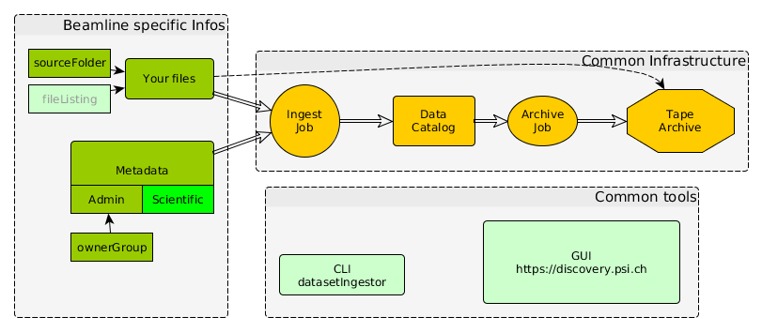
How it works: adding data
See https://discovery.psi.ch/help/ingestManual for details
You can run the tools either with your personal account or for the beamline managers using a beamline account provided for each beamline

Slide 4
What do you need to do ?
Often the situation today is like this: you have your data stored on some (central) file server within certain folder locations. You may have additional files “somewhere” annotating this data
Preparation for Data Catalog is a two step procedure:
  Step 1: define your Datasets (collection of files belonging together)
  Step 2: Enrich the data with Metadata
Depending on you situation you may add this information manually or automatically.
See https://discovery.psi.ch/help/ingestManual for all details

Slide 5
1. Define Datasets
Datasets are the smallest unit for archiving, retrieving and publication
Create them by defining filelists, e.g. for raw data list all the files that logically belong to a measurement/data taking run. In the simplest case this is just the name of a folder: all files within are taken as the dataset files
In addition to “raw” Datasets you can create “derived” datasets containing the results of your analysis derived from the raw data. This ingest step is usually done by the user pursuing the analysis
Warning for raw data : avoid to use the symlinks from the “data” (=eaccount home) folders to the real data locations
/sls
X02DA
Data10
Data20
X12SA
Data1
e12345
sample
Measurement-run-1
Measurement-run2
e16532
measurementX
Imagefile1
imagefile2
Green Boxes are candidates for
Dataset definitions

Slide 6
Set up metadata.json
Define data ownership by assigning a p-group via Digital user Office DUO.
  Only members of the pgroup get access to the data. Membership defined by beamline manager BM or principal investigator PI
  There is a one-to-one mapping from e-accounts to pgroups, e.g. e-account “e12345” has a p-group “p12345”
  Most p-groups are linked to proposals
Define minimal administrative metadata (more is possible)
Put all information into a file “metadata.json” (JSON is a format both easy to read for humans and computer)
{
"principalInvestigator": "federica.marone@psi.ch",
"creationLocation": "/PSI/SLS/TOMCAT",
"sourceFolder": "/data/experiment/run/17",
"type": "raw",
"ownerGroup":"p16623“
["scientificMetadata “ : optional, see next slide]
}

Slide 7
2. Define Scientific Metadata
The definition of scientific meta data is completely up to the scientific discipline.
Ideally follow a standard if it exists, e.g. Nexus based HDF5 files
Scientific metadata can also be added later
Just an example:
“scientificMetadata": {
"beamlineParameters": {
"Monostripe": "Ru/C",
"Ring current": {
"v": 0.402246,
"u": "A"
},
"Beam energy": {
"v": 22595,
"u": "eV"
}
},
"detectorParameters": {
"Objective": 20,
"Scintillator": "LAG 20um",
"Exposure time": {
"v": 0.4,
"u": "s"
}
}…
}

Slide 8
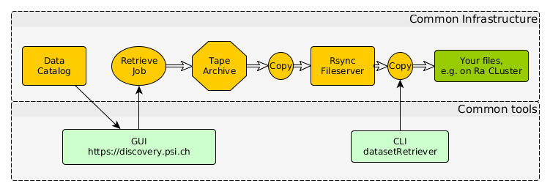
How it works: retrieving data
Retrieve Jobs are typically done for a larger set of files which should be subject to further data analysis. Often they are fetched for a group of people, e.g. to get all data of a previous measurement period.

Slide 9
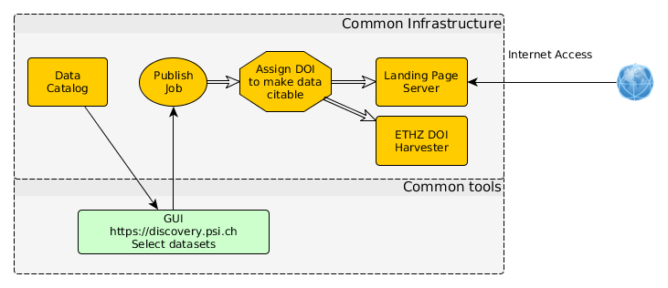
How it works: publishing data (WIP)
Process is driven by researchers who want to publish in a journal
They define a list of datasets as “published data”, for which a DOI is assigned.
Data will be published on landing page server https://doi.psi.ch

Slide 10
Next steps
Answer questionnaire (needed for rollout planning)
  https://docs.google.com/forms/d/e/1FAIpQLSd3p0TvXy4p8_ty3nsPYp4nhtKfVuTq4SmmvKHGwlxVjLS2iw/viewform?vc=0&c=0&w=1&usp=mail_form_link
  e.g. to define contact persons, suitable dates for first ingest test, automation requirements at beamline etc
Discuss with your colleagues
  if you want to ingest historic data as well
    data migration of data still on disk
    data migration from old archive will be treated as a dedicated project
  Discuss which of the newly created data should be ingested to the data catalog and at what time (directly after data taking ? Automatically or manually ?)
  Get in contact with us ( via datacatalog@psi.ch, currently Luke Gorman, Peter Huesser, Edgar Barabas, Stephan Egli)

Slide 11
Begin of Additional Material

Slide 12
What is SciCat
A collaboration between PSI, ESS European Spallation Source and MaxIV Swedish Synchrotron Lab to create a data catalog management system for scientific data
Aims to support the management of the whole data lifecycle
Common Codebase with Gitflow based development workflows
Open source (https://github.com/scicatproject)
Modular design to cope with evolving requirements from scientists
Technical architecture based on Microservices with the latest web technologies

Slide 13
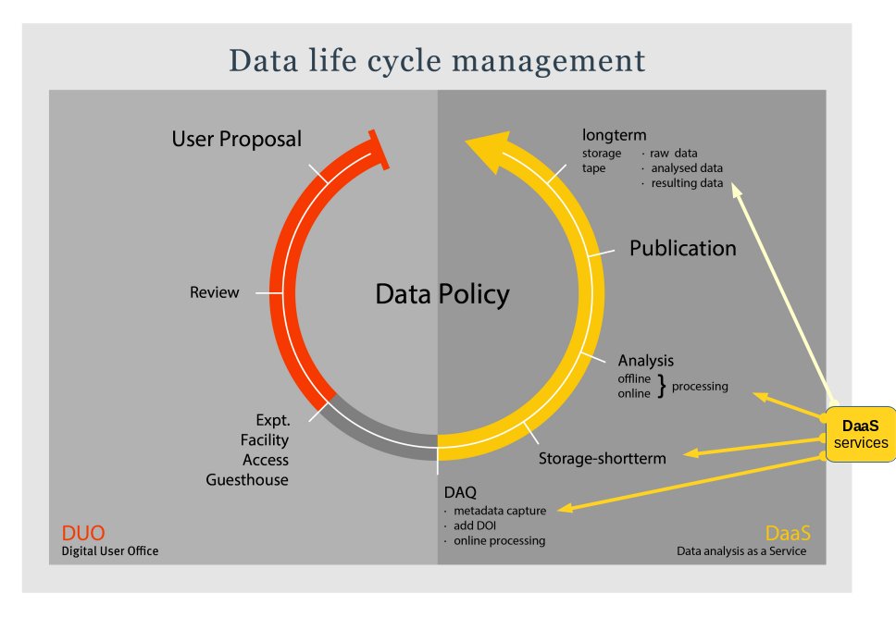
Bigger Picture:Data Lifecycle Management

Slide 14
FAIR principles
Required by SNSF (Swiss National Science Foundation),see http://www.snf.ch/en/theSNSF/research-policies/open_research_data
Findable: Data and Metadata should be easy to find by both humans and computer
Accessible: longterm storage and access via standard communication protocols
Interoperable: Data should be ready to be exchanged, interpreted and combined in a (semi-) automatic way
Reusable: Data and Metadata are sufficiently well described to allow data to be reused in future research

Slide 15
(Non-functional) Goals and Challenges
Flexibility in terms of
  covering the needs of the researchers , especially in terms of scientific meta data handling
  integration into existing environments
  ease of interfacing, enabling the researches to do the ingests
  from the beginning have customization to and deployments in other sites in mind
Speed of changes
  allow to add new instruments easily
  allow to add new features in short time
Longterm stability without being constrained in meeting new requirements
  allow for constant evolution both in terms of features and volume. This concerns the whole DevOps processes

Slide 16
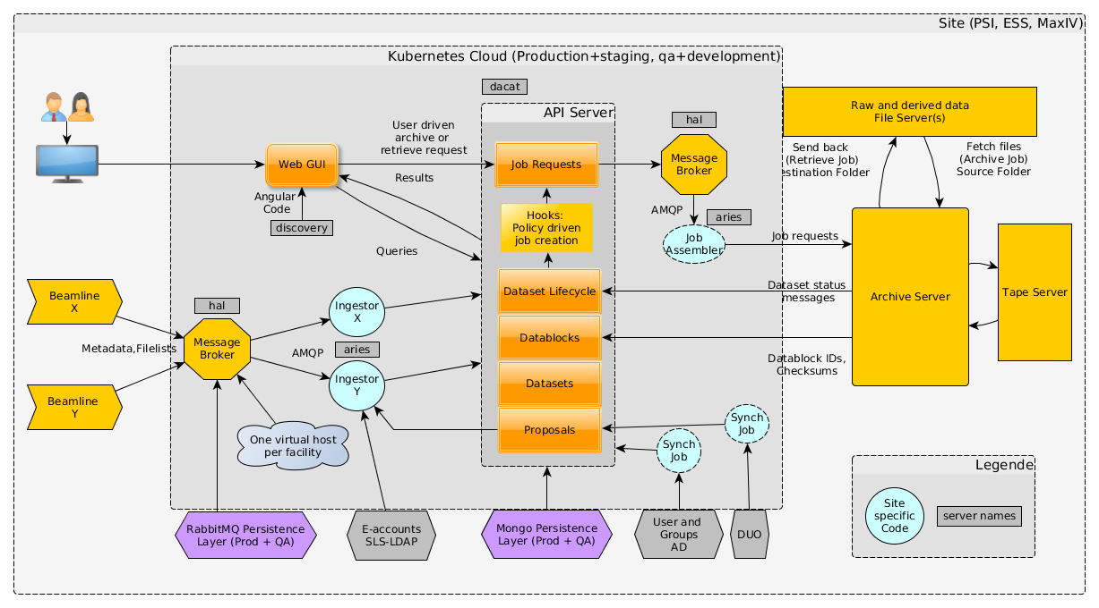
Overall Data Catalog Architecture

Slide 17
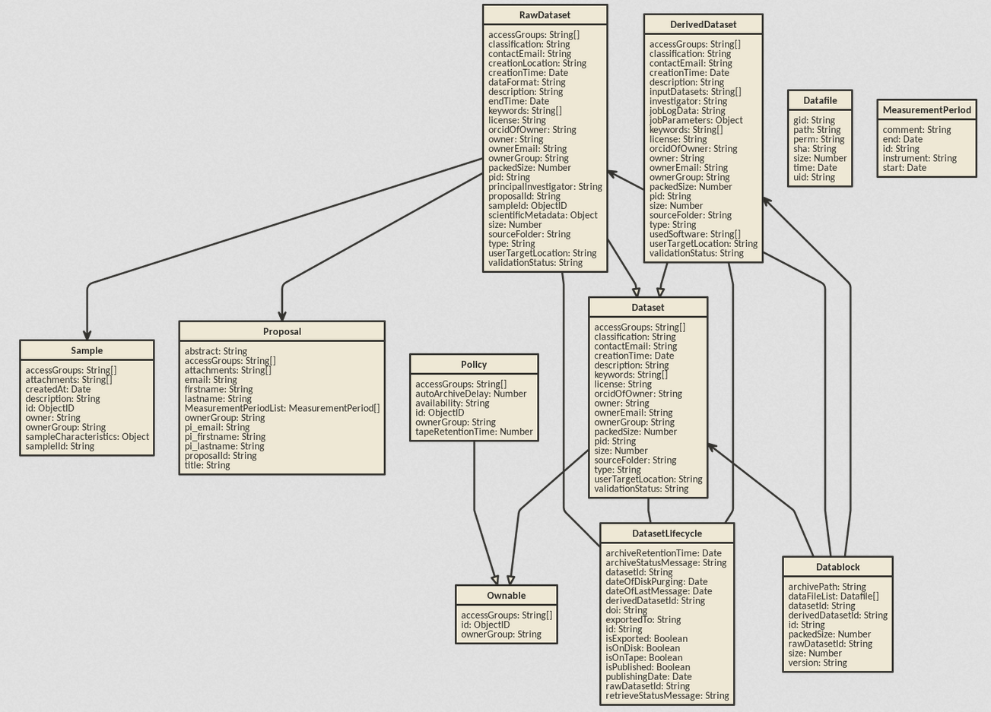
Data Model: Raw/Derived Datasets, Proposals…

Slide 18
Scientific Meta Data
Scientific meta data is up to the beamline managers to define (in collaboration with the users)
Aim for standardization, e.g. via use of HDF5 and Nexus formats
The catalog per se does not pose any limits here
See example on next page. . .

Slide 19
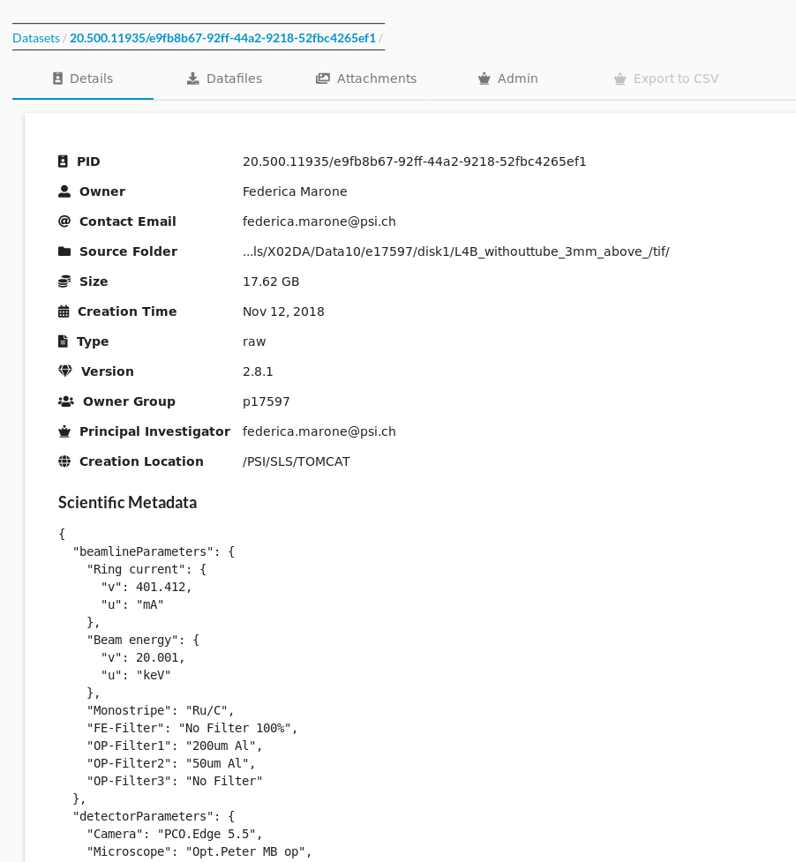
Example of Scientific Metadata

Slide 20
Datastore
MongoDB backend
NoSQL - Document based storage, collections,"schemaless"
Map/Reduce/Facet Aggregation queries
Powerful indexing and support for file storage
Fault tolerant and drivers for most languages

Slide 21
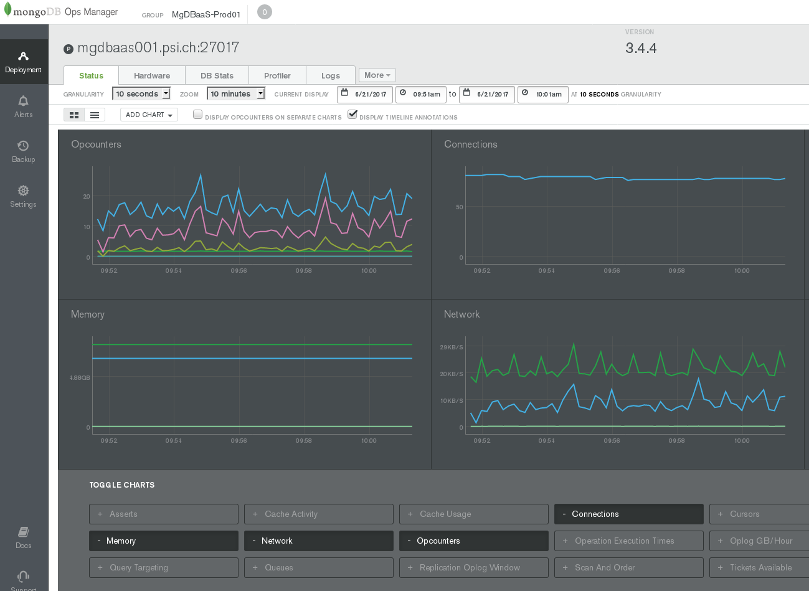
MongoDB Ops Manager

Slide 22
API Server
Loopback (API creation framework based on NodeJS and Express)
APIs auto generated from JSON configuration to configure data model
  Can create SDKs for many target languages
Plugins for authentication
Business logic can be added in Javascript files
Auto documenting
Swagger based API creation (OpenAPI standard)
User accounts (through central IDM system) and functional accounts with roles for different administrative activities within the system i.e. Archiving

Slide 23
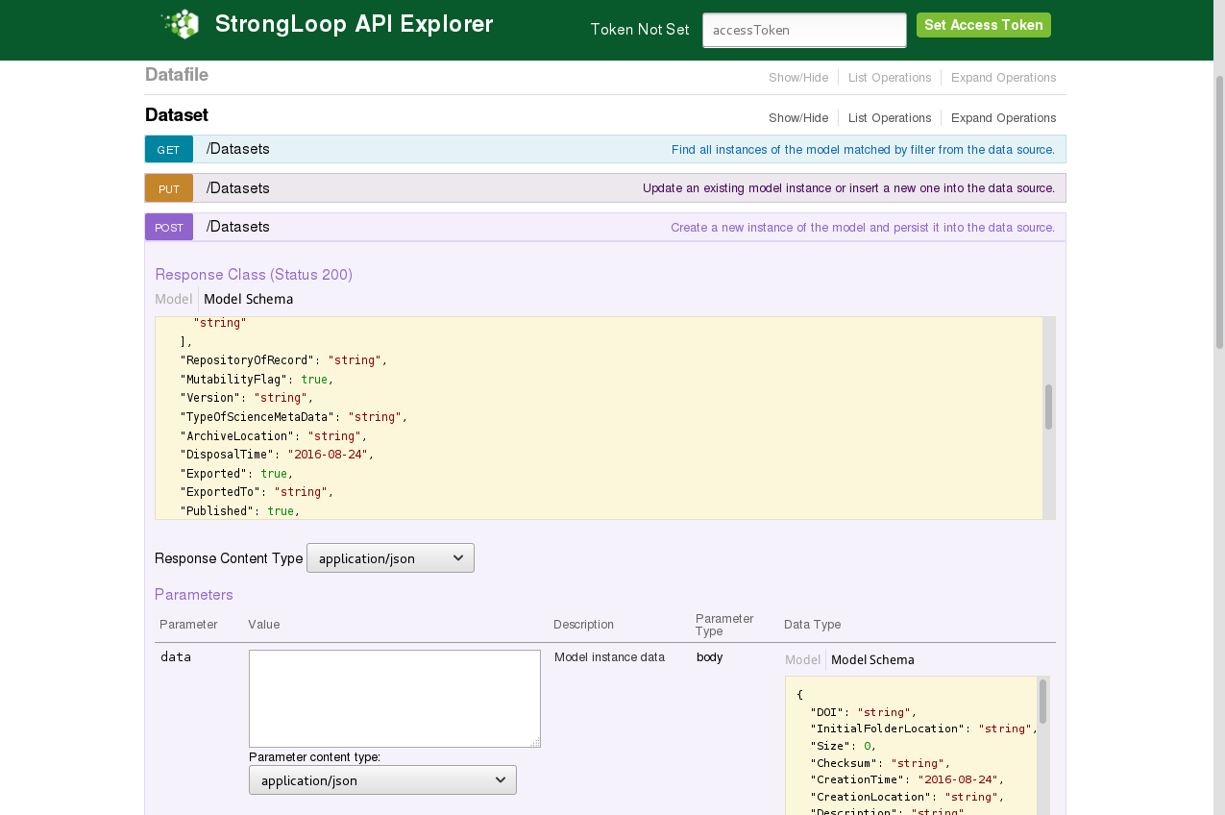
Screenshot of API Explorer

Slide 24
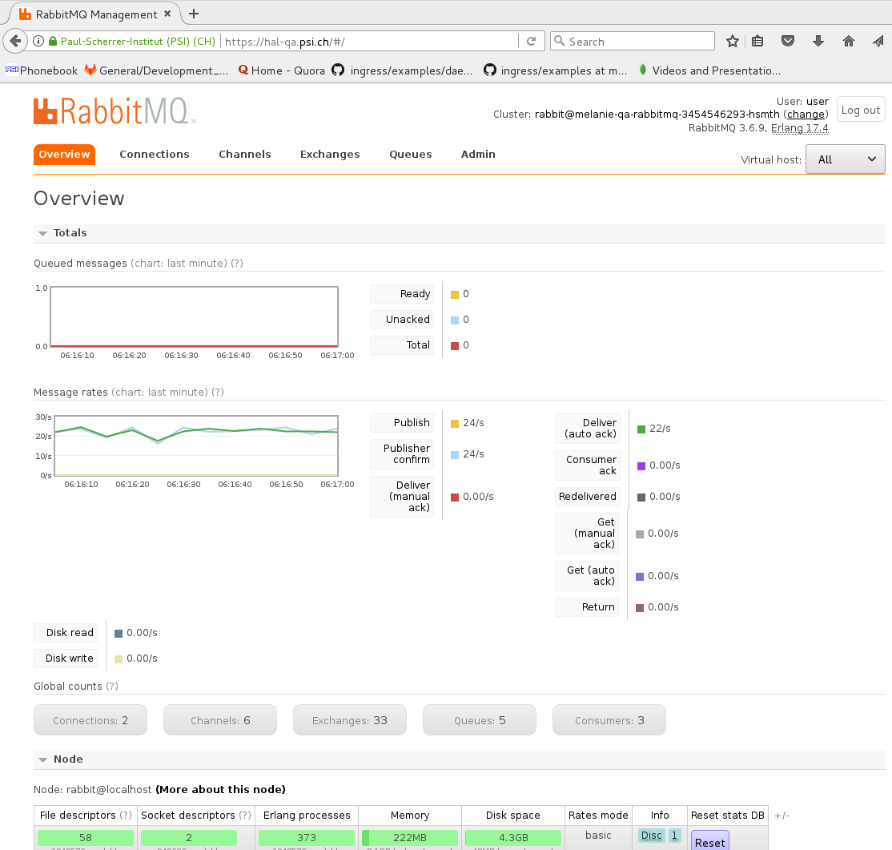
Message broker RabbitMQ Managament
Ingesting Data
From Beamlines

Slide 25
Data Handling
Node-RED
Javascript visual programming flow framework for the Internet of Things
Data received from RabbitMQ and formatted according to the data model
Dataflows publish formatted data to API server

Slide 26
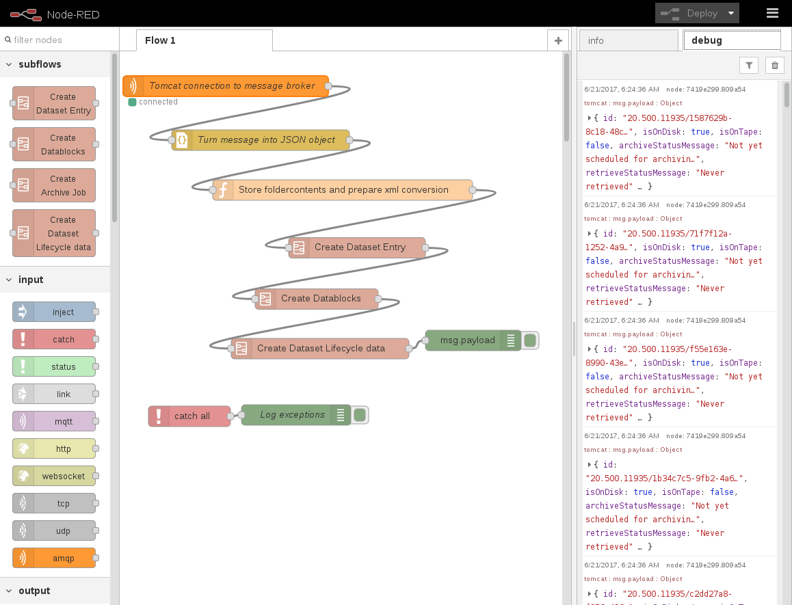
Node-Red Dataflow based coding

Slide 27
Frontend
Built using Angular 6 and Ngrx
Created with Typescript
Component based architecture to reuse throughout the application
Based on Angular Material Widget Set
Responsive, Standards compliant

Slide 28
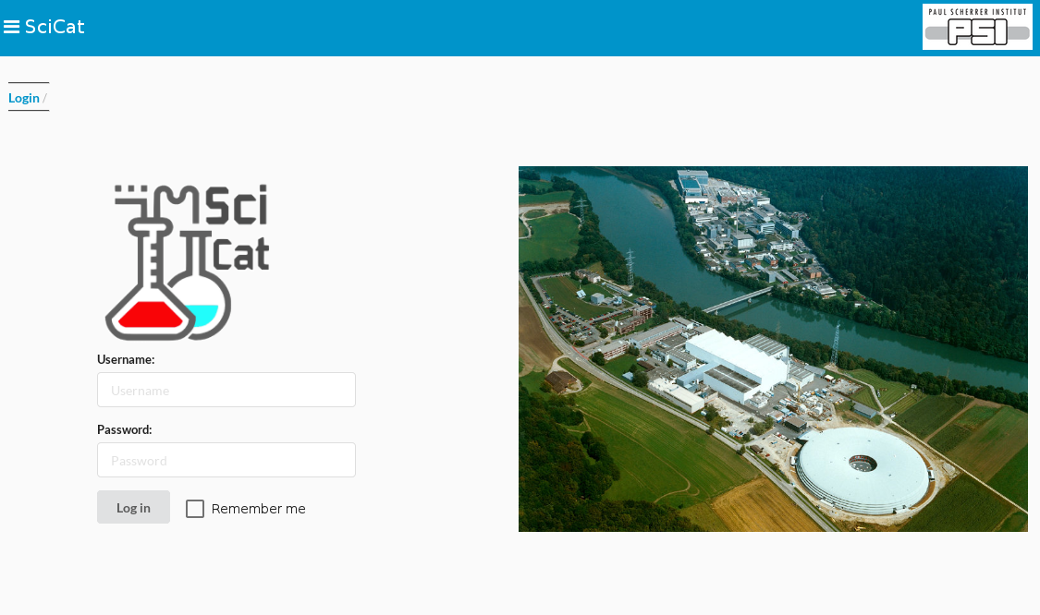
Frontend Login

Slide 29
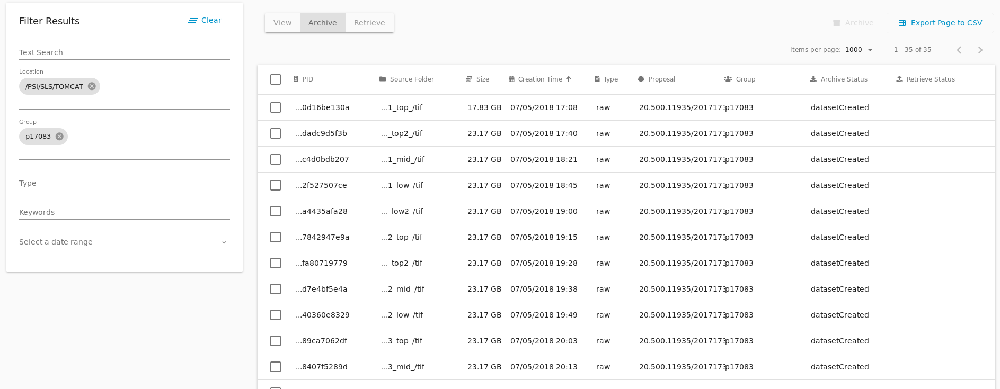
Dataset Listing and Navigation

Slide 30
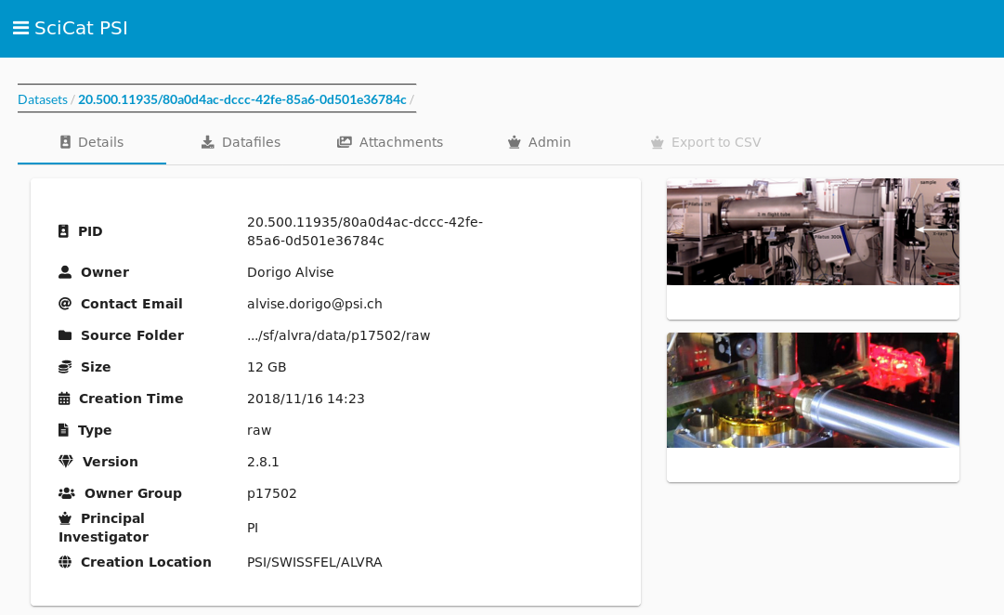
Dataset and Attachments

Slide 31
Management and deployment
Different deployment options, with and without container technology are available
Preferred method is via a Kubernetes cluster
Each microservice is built into a docker file and saved in a registry
Kubernetes and Helm package manager deploys the containers and handles:
  Routing
  Scaling
  Server failures
  Updates

Slide 32
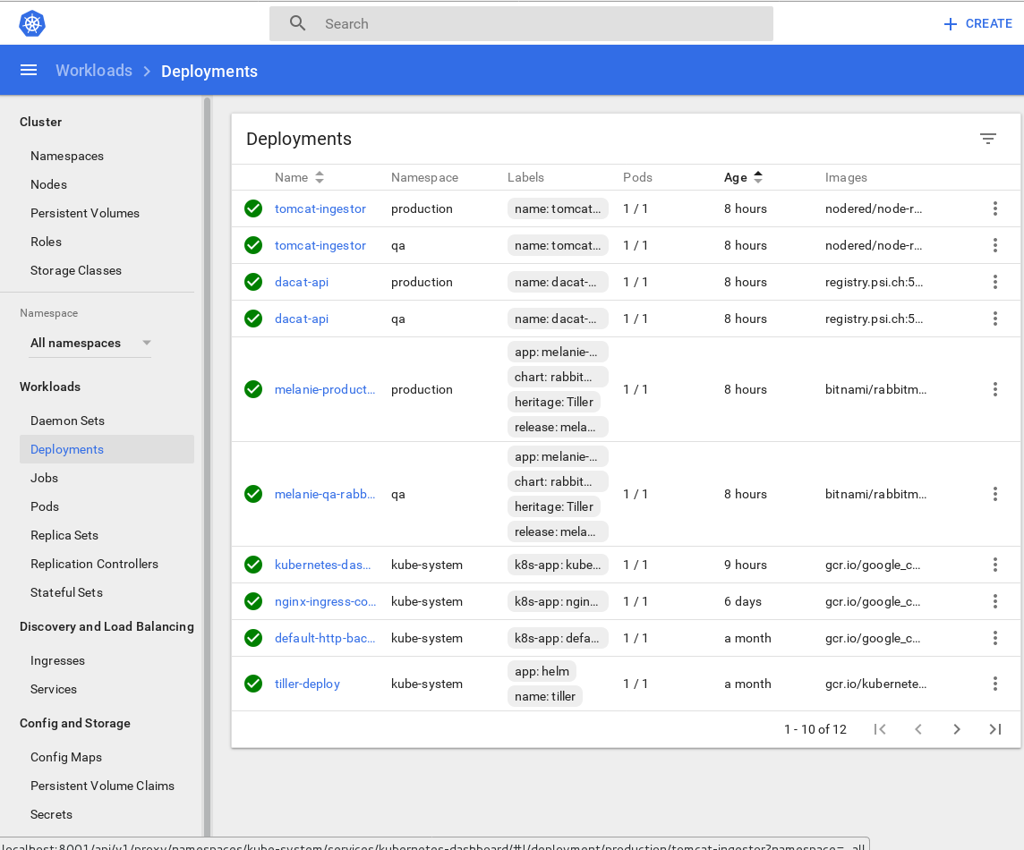
Kubernetes Management Dashboard

Slide 33
Overall Data Catalog Architecture

Slide 34
Extra Material

Slide 35
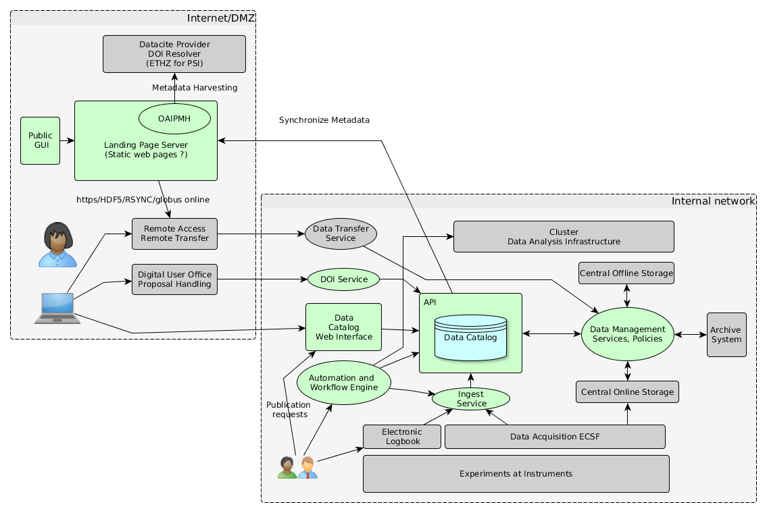
Architecture Update for Publication Workflow

Slide 36
PSI Data Policy
Has become public recently, see https://www.psi.ch/science/psi-data-policy, based on work done within PanData EU Projects
Main points
  The policy defines the data ownership, curation, archiving and open access
  Data custodian (Head of research division) and data owner (Principal investigator)
  Data retention for minimum five years, striving for ten years
  Default embargo period of three years (with option for five years)
  Implementation bases on Metadata Catalogue, PetaByte Archive and remote access functionality

